Slide 1
Office of Clinical Research
Legal Services (fka CTCU)

Slide 2
Introduction to OCR Legal
OCR Legal consists of attorney and non-attorney negotiators who negotiate and execute agreements in support of clinical research funded by industry. We also have contract coordinators who do all of the intake and work closely with the parties in the execution and management of the various agreements handled by OCR Legal. Agreements include Non-Disclosure Agreements, Clinical Trial Agreements (CTA), Material Transfer Agreements (MTA), Data Use Agreements (DUA), and Collaboration Agreements, and a host of other types of agreements, including completely customized agreements to suit the specific needs of a project. OCR Legal also collaborates with other OCR and Penn offices, including the Penn Center for Innovation, the Office of Research Services, the IRB, and the Office of General Counsel, as necessary.

Slide 3
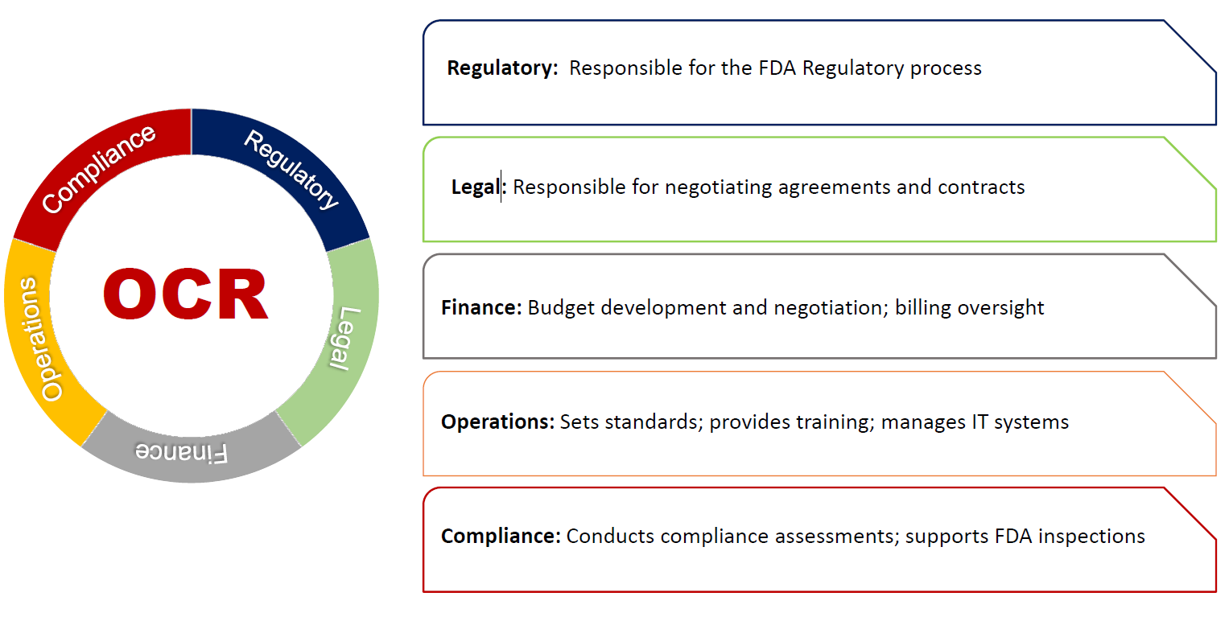
Central Support for Research

Slide 4
Which Penn offices negotiate research agreements?
PCI
Corporate Partner- PreClinical & Animal Studies
(when informed consent is not involved)
ORS
Federal, Foundation, Nonprofit Partner Research
PI
ACC
*Please always be comfortable contacting OCR Legal early and often with any legal or contracting questions or concerns
Corporate Partner- Clinical (for Abramson Cancer Center only)
OCR*
Corporate Partner- Clinical Research
(human studies, when informed consent is required)

Slide 5
Purpose of Agreements in Research Context
To develop a contractual relationship with an outside party to facilitate research at Penn
Written understanding
Binding
Control for risk/ambiguity/misunderstandings
Agreements facilitate:
Funding of research at Penn
Transfer of materials or data
Collaboration in research among two or more parties
Commercial development of a product/device/intervention invented at Penn

Slide 6
Typical Process for Corporate Sponsored CT at PSOM
Contact made by Sponsor to PI
Sponsor-Derived Protocols;
For Investigator-Initiated Trials, PI Sends Protocol to Sponsor After Sponsor Signs CDA
If There is Mutual Interest between Sponsor and PI – Parallel Review
Budget by OCR Finance
IRB – funds provided in the Budget
Contract Review by OCR Legal
Trial Management by Sponsor or CRO

Slide 7
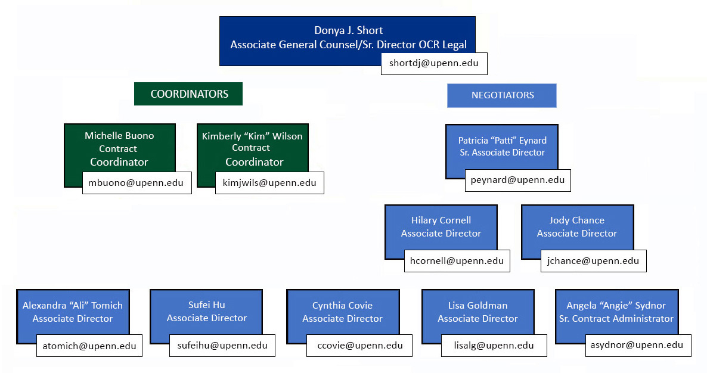
Our Team

Slide 8
What can Investigators do to facilitate the contract and budget negotiation process:
When you have sufficient reason to believe that a Corporate Sponsor is willing to provide support (exact amount need not be agreed upon) and that the Corporate Sponsor is ready to proceed with contract and budget negotiations in the near future:
For corporate sponsored contracts, use Parallel Review in PennEra (PennERA – Office of Research Services | University of Pennsylvania (upenn.edu)).
For non-monetary agreements use RIS (http://bit.ly/sJezea).
As noted in the parallel review instructions, you must send a notice to the mailbox (OCRLegalServices@pennmedicine.upenn.edu) at the time of submission of parallel review request. You will receive a notice when the matter is assigned.
Provide a template from Sponsor or an email from the Sponsor’s contract professional stating that they are willing to use Penn’s template.

Slide 9
Other Research-Related Agreement Submission
All non-monetary/material transfer agreements, subawards and fee-for-service agreements should be submitted via the Research Inventory System (RIS): https://researchservices.upenn.edu/systems/research-inventory-system/.
RIS is a Penn electronic system for requesting and managing research-related agreements that are not associated with incoming funding through three distinct modules: (1) Material Transfer Agreement and Non-monetary Agreement (MTA/NMA), (2) Subawards, and (3) Fee for Service.
Who Do I Contact?
Questions regarding corporate-funded clinical trial/research, contact the OCR Legal Services at OCRLegalServices@pennmedicine.upenn.edu.
Questions regarding industry sponsored activity, contact The Penn Center for Innovation (PCI) at corpcont@pci.upenn.edu.
Questions regarding activities related to a government agency or a non-profit entity, contact the Office of Research Services (ORS) at pennaors@lists.upenn.edu.

Slide 10
Other Research-Related Agreement Submission
Amendments:
Amendments may be required for various reasons including budget changes, a change in PI/Sponsor/CRO, or protocol changes that do not affect the budget.
Amendments to corporate-funded clinical trial and clinical research agreements may be initiated by creating a child record in the PennERA record of the original agreement with the exception of amendments solely requesting no-cost end date extensions, that have no contractual language changes and have a specific end date listed in the contract.
No-Cost End Date Extensions:
In order to initiate a request for a no-cost end date extension to an existing corporate-funded clinical trial or clinical research agreement, please send an email to OCRLegalServices@pennmedicine.upenn.edu.

Slide 11
Parallel Review Process
Parallel Review initiates OCR Legal’s review and negotiation of corporate-funded clinical trial and clinical research agreements simultaneously with the budget negotiations.
Initiating Parallel Review:
Create a PennERA record;
Upload the contract in word format under “Supporting Documents”;
Upload the protocol and the informed consent under “Research Plan”;
Provide the sponsor contact’s information on the proposal transmittal form;
Complete the Parallel Review e-form under “Internal Documents”;
Send an email to the OCR Legal’s mailbox (OCRLegalServices@upenn.edu) requesting parallel review; and,
In your email to OCR Legal provide the PennERA # assigned and any additional information.

Slide 12
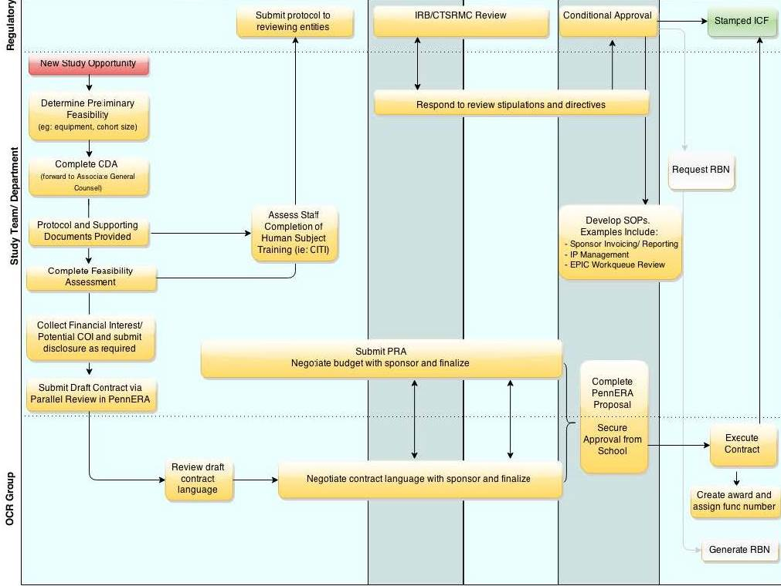
Study Initiation Process

Slide 13
Things to Consider- Key Issues in Research Agreements
ISSUE | EXPLANATION
Regulatory Compliance | Privacy Regulations – HIPAA, EMR, CTF, and Data Transfers (GDPR, CCPA).
Publication/Rights to Publish | As an educational and non-profit research institution, Penn’s basic mission is the discovery and publication of new ideas and technologies. Agreements should provide for the right to publish and present research results without letting sponsors keep study results confidential, prevent their publication, or “hide” bad results. Penn does not agree to give Sponsors approval rights on publications.
Confidentiality & Research Results/Data Generated in Research | Sponsors may try to impose significant confidentiality obligations onto Penn in their pursuit to claim and retain commercial advantage. Due to Penn’s openness in research policies, care must be taken to ensure proper balance of confidentiality obligations. Penn PIs must be allowed to use the research results and associated data generated in research for any reasonable purpose, including, without limitation, non-commercial research, educational, internal health care operations, patient care, and publication purposes. Penn must also always retain ownership of subject medical records and other documents generated for purposes of academic research, clinical care, or business operations.
Subject Injury Coverage | For a majority of clinical research involving a drug or device, the sponsor, who is providing the drug or device, should agree to provide funding to cover diagnosis and medical care costs for any research-related injury or illness experienced by research subjects.
Indemnification | Indemnification is when a party to an agreement agrees to defend and hold harmless another party from a third-party litigation claim. Penn does not typically agree to indemnify sponsors in the research context http://www.upenn.edu/almanac/v44/n06/ofrecord.html. Penn will often request that sponsors indemnify Penn (e.g., injuries from drug products resulting in malpractice claim, outside parties’ use of Penn’s data or materials).
Patient Data/Biospecimens | Penn Medicine recently issued guidance focusing on the prioritization of its role as a responsible steward of patient data and biological samples. The Guidance recognizes that Penn must comply with applicable laws, as well as limitations posed in the language of an informed consent regarding patient data and bio samples, and it also requires more optimized Sponsor restrictions, reporting, and transparency for entities in possession of Penn patient samples and/or data.
Intellectual Property (IP) | IP can involve patentable inventions, know-how, copyrightable material, trademarks, and can include IP that pre-exists the contractual relationship or is generated in the course of research. IP can be conveyed via “assignment” or “license.” IP involves complex issues of ownership/inventorship. It is very important for Penn to retain rights to IP for its research, clinical, and patient care activities.

Slide 14
GENERAL CONTRACTING HELPFUL INFO
Please always be comfortable contacting OCR Legal early and often with any legal or contracting questions or concerns.
It is always helpful when you submit agreement requests as early as possible so we can properly prioritize with high volume.
Contracts should only be drafted, reviewed, negotiated, and executed by a Penn contracting office.
Please be aware that any agreement, that Penn is a Party to, must be signed by a Penn authorized signatory.
Let us know as soon as you know of any special circumstances, or when you think or know there is IP, or when you know you will be sharing PHI.
We negotiate all agreements in accordance with Penn’s policies and contracting standards.
We are on the same side, please feel encouraged to collaborate with us so we can best address your needs - we are happy to customize agreements and approaches.
Please remember to maintain the confidentiality or attorney client privilege when it applies to Penn internal communications.

Slide 15
Contact Us
For requests related to corporate-funded clinical trial agreements (e.g., notification of requests for parallel review of agreements, requests for date extensions or questions that relate to corporate sponsored studies) mail: OCRLegalServices@upenn.edu
Office of Clinical Research (OCR) Legal Services Perelman School of Medicine 8041 Maloney 3400 Spruce Street Philadelphia, PA 19104-4238
Phone: 215-746-8913
Administrative Questions: Michelle Buono mbuono@upenn.edu and Kim Wilson Kimjwils@upenn.edu
Legal and Contracting Questions: Donya Short ShortDJ@Upenn.edu and Patti Eynard Peynard@upenn.edu

