Slide 1
@SDFlies #BGSOrientation #PENNBGS4U Today’s program:
Doing Research Responsibly — Steve, ~25min
Theme: Starting your Professional Life with Rigor
Laboratory Notebook — Steve, ~ 20min
Kate, Kara & Ben, ~ 40min total
Theme: organize, Organize, ORGANIZE!
Set up an Electronic Notebook — LabArchives Remote session on the BRB Screen, ~50min
Notes:
What are your goals? Give me some words…
Do Good science
Recognize good science
Help Others – Kelly talked about this a lot from the POV of you getting from others –remember that you guide others, too
You are creating your professional self.

Slide 2
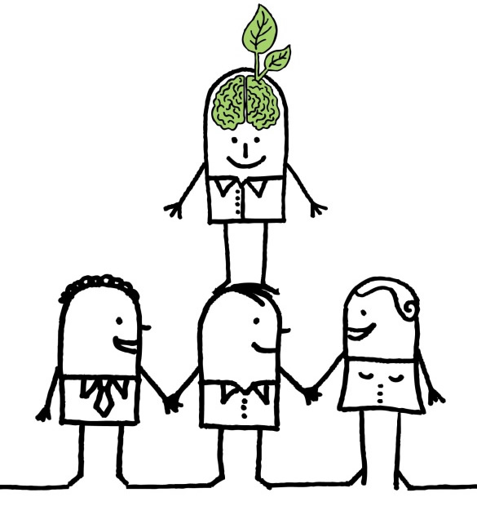
YOUR PRIMARY GOAL
CREATING YOUR ‘PROFESSIONAL SELF’:
Be the right shoulders to stand on!
Be here
Carrying out your science:
Responsibly
Reproducibly
& with Rigor!
Notes:
Requires that the science that came before is done Responsibly
Reproducibly
& with Rigor.

Slide 3
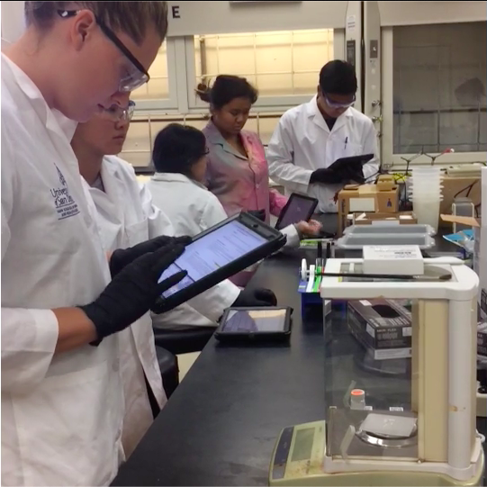
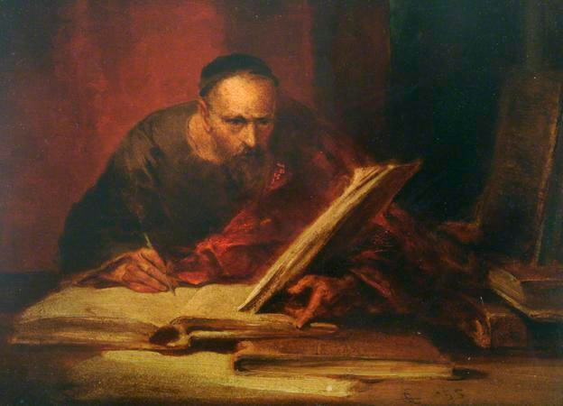
Management of Data:
The Laboratory Notebook
George Cattermole – The Scribe
The laboratory now:
We’ve come a long way!
https://www.labarchives.com/
Notes:
Nothing much to say – just Welcome back from Lunch. We will spend some time on “The Laboratory Notebook”

Slide 4
Lab Notebook: Why is it important?
1.
2.
3.
4.

Slide 5
Lab Notebook: Why is it important?
1. Others can reproduce your work
2. Patents
3. Defending claims of misconduct
4. Saves you Time, Energy & Effort
This is the way to do ‘Rigorous Science’
Each a
‘noble’ reason
for a good
notebook
The reason that will impact YOU most often:

Slide 6
Example: Is this a good notebook?
Notes:
Tell me some things that are wrong with this “notebook?
OK –Lots ‘wrong’.
Is this common? Let’s look at a case study.

Slide 7
Example 2: A (true) case study
Dr. B. convenes a lab meeting in which she asks everyone to bring their notebook.
“Pass your notebook to the person to your right”.
“Take a few moments and quietly read the most current entry.”
Notes:
Follow along …

Slide 8
Example 2: A (true) case study
“Now, each of you summarize what you read”.
Virtually no one can give a scientifically satisfactory summary.

Slide 9
Example 2: A (true) case study
Why can’t anyone provide
a satisfactory summary?
There were many issues:
Handwriting
Haphazard organization
Little or no context
Lack of detail in the protocol
No outcome
No ‘what next?’
Notes:
True story. Maybe for ‘Scavenger Hunt’ you should be charged with figuring out who ‘Dr. B’ is, and who owned that horrid notebook I showed earlier?

Slide 10
Lab Notebook Guidelines
How to find anything?
Organization is key
First at the level of the whole notebook
‘Table of Contents’ is essential
see Kate’s talk next.
Second at the level of individual experiment
Notes:
Drawing back to the notebook as a whole, be sure…

Slide 11
At the level of individual experiments:
Make and date entries daily.
Why? Memory is faulty.
Make entries in Ink or Electronically (→ next talks)
Why? They need to be indelible.
Pay attention to grammar for ‘readability’.
Document everything.
Don’t ‘filter’ out bad, or ‘wrong’ experiments.
Omitting data is dishonest.
See Responsible Conduct of Research (Shamoo & Resnick) and Scientific Integrity (Macrina)
Notes:
Lesson from this Case Study is our first guideline. [Read first bullet point]
It’s very important to know as you’re making entries that you must [read sub-bullets]

Slide 12
Provide ‘Context’ to your Exp’t:
Purpose: What are you proposing?
What is the rationale?
Connect the experiment to previous work.
Does it reflect a mentor’s or peer’s advice?
Anticipate the results:
What do you expect?
Why?
Keep these entries simple!

Slide 13
Lab Notebook: How was it done?
Protocol: A critical section.
Include details: lot numbers, expiration dates;
it’s OK to cite a frequently-used protocol.
Did you alter the protocol this time through?
Changes might affect your results.

Slide 14
Lab Notebook: What happened?
Results: Enter raw data or a link to storage.
Discussion: Do results agree with your expectation?
If not, why not? Did departures from protocol have an impact?
Future Directions: What next?
Write while your ideas are fresh.
Keep these last entries simple!

Slide 15
Lab Notebook:
As you go back through your notes –
If you have after-the-fact thoughts, by all means make annotations
Date those annotations.
Notes:
…think weekly

Slide 16
Lab Notebook:
At some frequency --
Your PI should review, sign + date your notebook: this is ‘Authentication’.
Notes:
…think weekly

Slide 17
Lab Notebook: The Bottom Line --
Could a colleague understand the experiment fully from your entry?
Can you reproduce it a year from now? This is the part that
Saves you Time, Energy & Effort and
provides for Rigor.

Slide 18
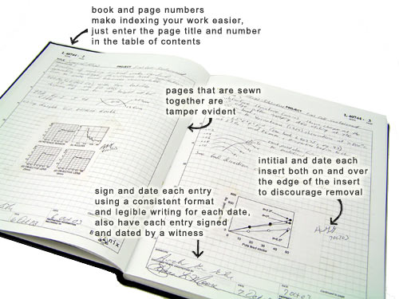
How does one achieve all this ‘Organization’?
Kate Palozola, Postdoctoral Fellow
(& CAMB PhD!)
“On File Naming & Organization”
Notes:
One form of the notebook, and the one with which most of you are familiar, is the traditional bound notebook.

Slide 19
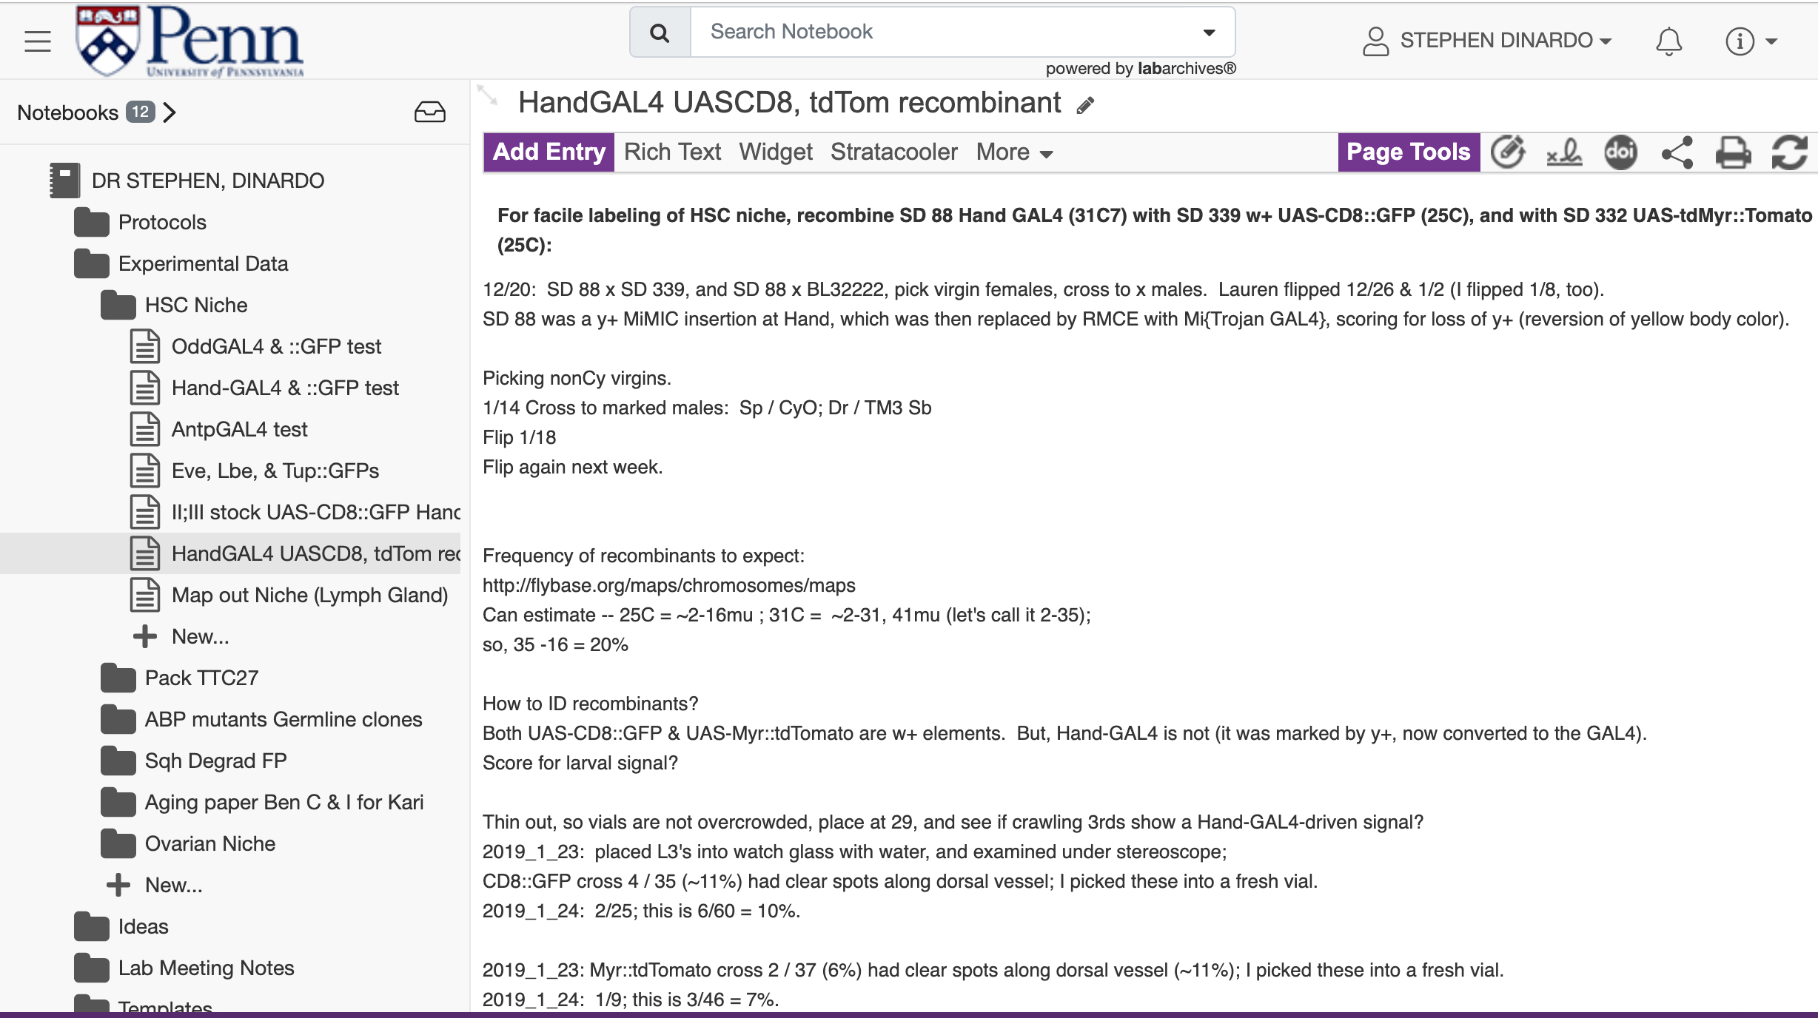
Benefits of an Electronic Notebook
→
Kara McGaughey, PhD Student
“Why you should use an eNotebook”.
Notes:
One form of the notebook, and the one with which most of you are familiar, is the traditional bound notebook. [Describe] Another is the electronic lab notebook, which we’ll describe in the next hour. My comments unless I tell you differently relate to both.

Slide 20
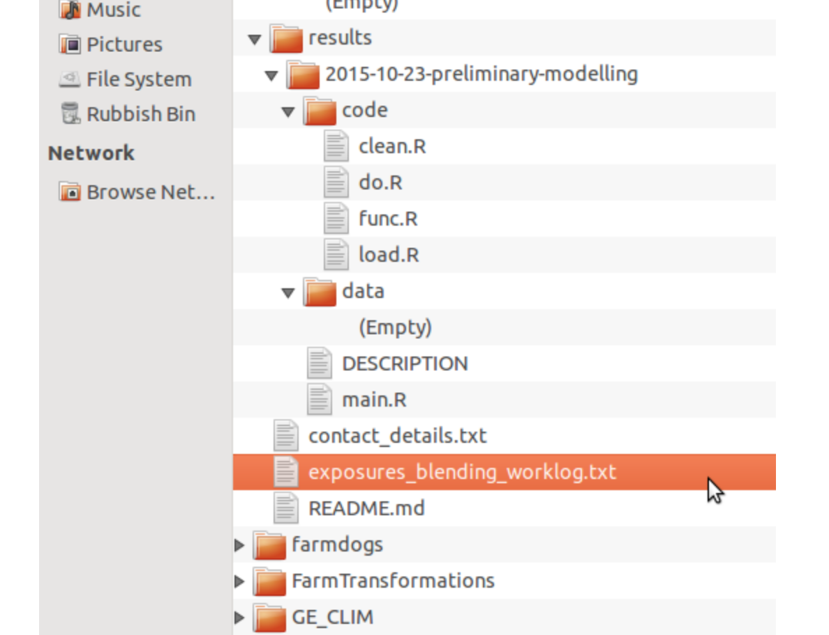
Type of Research => Kind of Notebook
→
Benjamin Heil, Postdoctoral Fellow
“Recording Computational Work”
Hanigan site:
https://ivanhanigan.github.io/2015/10/keeping-an-electronic-lab-notebook-for-computational-statistics-projects/
Notes:
One form of the notebook, and the one with which most of you are familiar, is the traditional bound notebook. [Describe] Another is the electronic lab notebook, which we’ll describe in the next hour. My comments unless I tell you differently relate to both.

Slide 21
FYI: Who ‘owns’ your Notebook?
Notebooks are under the care of the PI, but ‘belong’ to the University.
Must be retained for a long period.
Required retention period can be long after funding ends.
Notes:
A related topic is ownership. You are not the owner, nor is your PI.

Slide 22
Build good habits early!
For example, during your rotation:
Ask your supervisor or PI to review your notebook weekly and provide suggestions.
Notes:
So I’ve covered the organizational rudiments in terms of guidelines. To keep everything honest, you should know every principal investigator has a distinct set of preferences in this regard. Here’s my strongest recommendation.

Slide 23
Please: avoid this!
Notes:
So, let’s figure out how to avoid this …

Slide 24
Benefits of an Electronic Notebook
→
My notebook (years ago) now looks like this (an eNotebook).
Notes:
One form of the notebook, and the one with which most of you are familiar, is the traditional bound notebook. [Describe] Another is the electronic lab notebook, which we’ll describe in the next hour. My comments unless I tell you differently relate to both.

Slide 25
@SDFlies #BGSOrientation #pennbgs4u Today’s program:
Doing Research Responsibly — Steve, ~25min
Theme: Starting your Professional Life with Rigor
Laboratory Notebook — Steve, ~ 20min
→ Kate, Kara & Ben, ~ 40min
Theme: organize, Organize, ORGANIZE!
Set up an Electronic Notebook — LabArchives On the BRB big screen: 11AM to noon https://labarchives.zoom.us/j/96596449944?pwd=OEJORTZKd2ZEWlJiNVlnOWJhd3RJUT09 Link is in your schedules
Notes:
What are your goals? Give me some words…
Do Good science
Recognize good science
Help Others – Kelly talked about this a lot from the POV of you getting from others –remember that you guide others, too
You are creating your professional self.

Slide 26
@SDFlies #BGSOrientation #Pennbgs4u Shout out to:
→ Kate, Kara & Ben
Theme: organize, Organize, ORGANIZE!
NEXT, if you wish - 11AM to noon; On the BRB screen
Set up an Electronic Notebook — LabArchives -- Establish an account (free; LA is Penn-sponsored)
-- Set up your Electronic Notebook
-- Be guided through recording an experiment
-- Tips-n-tricks to make lab life more efficient and your experiments more rigorous
https://labarchives.zoom.us/j/96596449944?pwd=OEJORTZKd2ZEWlJiNVlnOWJhd3RJUT09
Notes:
What are your goals? Give me some words…
Do Good science
Recognize good science
Help Others – Kelly talked about this a lot from the POV of you getting from others –remember that you guide others, too
You are creating your professional self.

