Slide 1
Research Computing at the Perelman School of Medicine
Li-San Wang
Associate Dean for Computing

Slide 2
PSOM Information Technology Support
Working with Penn Medicine Information Services and University Research Computing Support
UPHS
PSOM
University
Data and Technology Solutions
Marylyn Ritchie Vice Dean, AI and Computing
Office of Vice Provost, Research
Entity Services
Infrastructure Technology
Information Security
Applications Digital Health
Li-San Wang Associate Dean, Computing
Institute for Biomedical Informatics
Penn Advanced Research Computing Center (PARCC)
Information Services and Computing
Computing Infrastructure
Research Information Systems
Penn Medicine Academic Computing Services (PMACS)
Application Development
Entity Information Officer

Slide 3
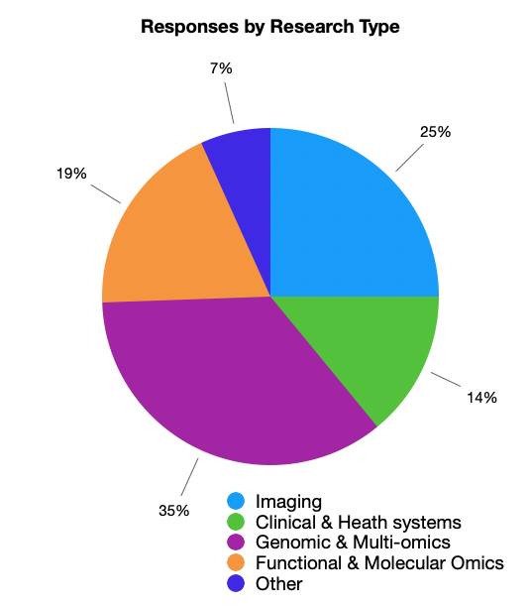
Research Data Types
1. Imaging-Based Research
2. Clinical and Health Systems Data
3. Genomic and Multi-Omics Data
4. Functional and Molecular Omics
5. Other
Source: 2025 PSOM faculty survey on research computing

Slide 4
Source: 2025 PSOM faculty survey on research computing

Slide 5
Shared Research Computing Environment
Shared Computing Resource | PMACS High Performance Computing (HPC) environment | PMACS Limited Performance Computing (LPC) environment | CUBIC | Penn Advanced Research Computing Center (PARCC)
Owner | PMACS / Penn Medicine | Contributing lab PIs / managed by PMACS | CBICA / Radiology / Penn Medicine | University ISC
Availability | Faculty, staff, and students of the University of Pennsylvania and other non-profit organizations | Available to PMACS users but lab members of owners of individual servers have higher priority | Available to CBICA members. PSOM faculty can reach out to CBICA for membership | Pilot phase begins spring 2025, will be available to PSOM researchers later in 2025
Servers | 76 nodes, 256-512 GB RAM/node 1 big memory node with 1.5TB RAM and 96 cores Total 6,080 cores, ?? RAM | Varied | 169 servers 4 servers/160 cores for Interactive sessions Total 11,368 cores, 70TB RAM | 64 nodes with 384 GB RAM/node 10 high memory nodes 1,156 GB RAM/node Total 4,736 cores, 36TB RAM
Storage | 4.2PB GPFS (no backup) | Varied | 1.5PB highly available storage | 2.5PB flash storage, 2.5PB HDD storage
GPU | 2 GPU nodes each with a single NVIDIA Tesla P100 GPU. 4 GPU nodes each with 4 x NVIDIA GPU H100 with 80GB/GPU. | Varied | 128 GPUs (20x A100-80, 26x A40-48, 4x V100, 76x P100) on 64 nodes | 248 B-200 GPUs
URL | https://www.med.upenn.edu/hpc/ | https://www.med.upenn.edu/pmacs/computing.html#LimitedPerformanceComputingClusterLPC2 | https://www.med.upenn.edu/cbica/cubic.html | https://research.upenn.edu/resource/about-parcc/

Slide 6
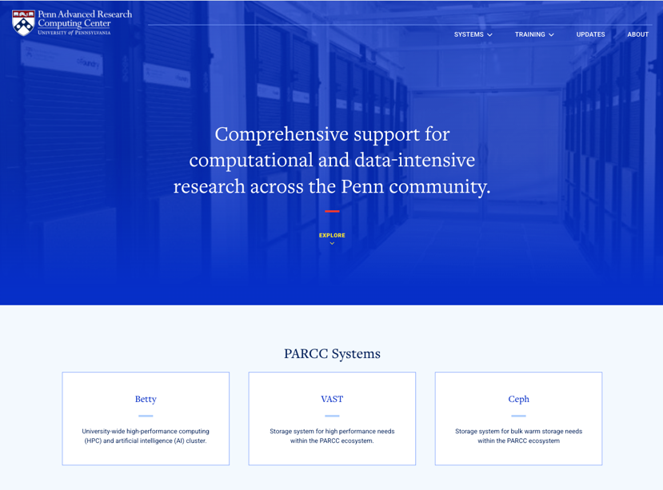
PARCC
https://parcc.upenn.edu/
DGX B200 SuperPOD - Latest architecture from NVIDIA
Component | Specification
GPUs | 8× NVIDIA Blackwell B200 GPUs with NVLink and NVSwitch
GPU Memory | 180 GB HBM3e per GPU (1.4 TB total per DGX B200)
Peak/Sustained Performance (cluster wide) | 8.5 PFLOPs
Peak/Sustained Performance (single node) | 274 TFLOPs
CPU | (2) 2.1 GHz Intel Xeon Platinum 8570 processors, 112 cores
Cores/Socket | 56
Sockets | 2
Total CPU Cores | 3474 cores
Total Accelerators/GPU Cores | 36,704
CPU Memory | 2TB DDR5
Storage (local) | 30.72 TB local NVMe storage
Networking | 200 Gbps Ethernet 2× ConnectX-7 NDR400 Storage Fabric Connection 8x ConnectX-7 NDR400 Compute Fabric Connection

Slide 7

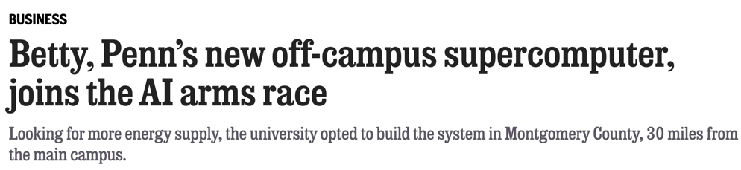
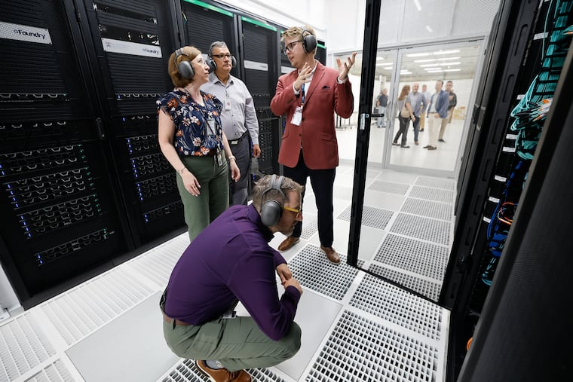
by Joseph N. DiStefano
Published July 27, 2025, 5:00 a.m. ET
Michael Borda, the associate vice provost for Research and the executive director of Strategic Initiatives, takes a closer look at Betty, the University of Pennsylvania's new supercomputer in Collegeville, as Marylyn Ritchie (rear left), vice dean of Artificial Intelligence and Computing at the Perelman School of Medicine, and Jaime Combariza, executive director of the Penn Advanced Research Computing Center, listen to Kenneth Chaney, the center's associate director of AI and Technology.Yong Kim / Staff Photographer

Slide 8
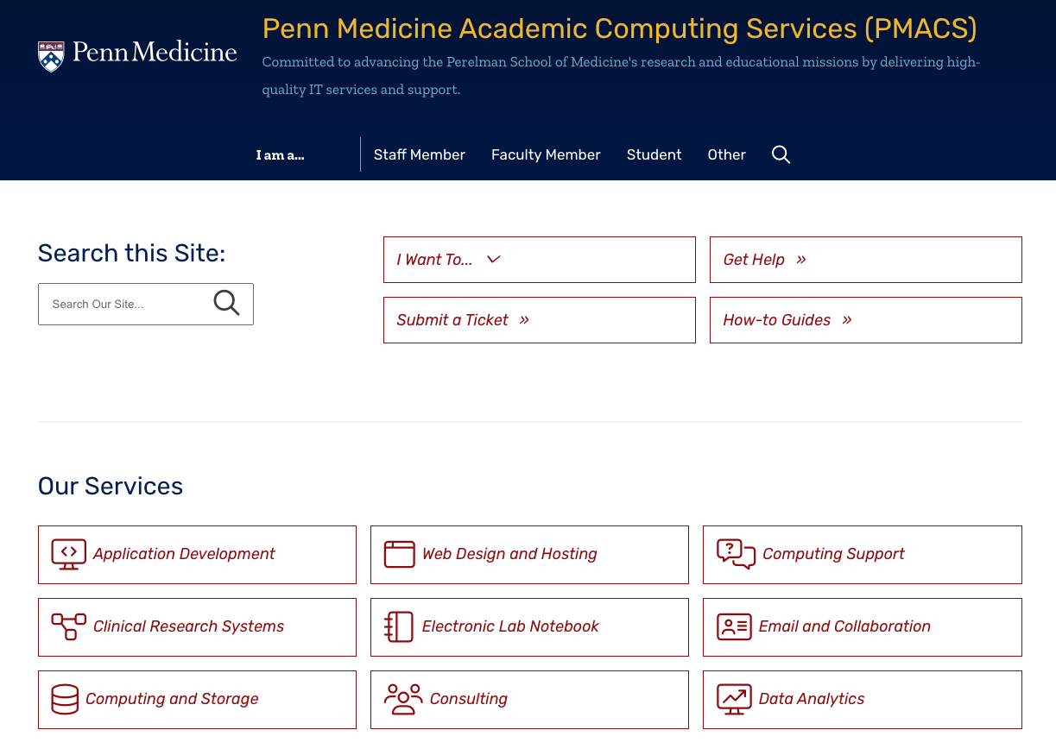
Penn Medicine Academic Computing Services (PMACS)
https://www.med.upenn.edu/pmacs/
PMACS supports your computational infrastructure and software needs
Application Development
Web Design and Hosting
Computing Support
Clinical Research systems
Electronic Lab Notebook
Lab Information Management Systems
Email and Collaboration
Computing and Storage
Consulting
Data Analytics

Slide 9
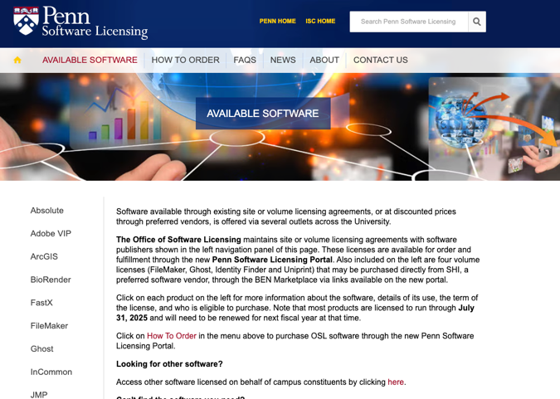
Software Licensing
Access to Microsoft Office Suite
https://www.med.upenn.edu/pmacs/email/penn365
Penn Medicine O365 is the cloud-based email and calendaring service deployed to every UPHS and PSOM faculty and staff member. The subscription-based service includes a number of additional benefits: the full suite of Office 365 ProPlus applications (Word, Excel, PowerPoint, OneNote, Outlook, Publisher, and Access) as well as Microsoft Teams.
Eligibility: Perelman School of Medicine (PSOM) Faculty, Staff, and Students are eligible for Penn Medicine O365 accounts.
You can also install office suites on your personal computers and device (up to 5)
Your Penn Medicine O365 account is a Microsoft account that provides access to Microsoft Office 365 services and applications.
Your Penn Medicine O365 username is your full Penn Medicine email address. Your Penn Medicine O365 password is identical to your Penn Medicine email password. When you authenticate for Penn Medicine O365, you must enter your full Penn Medicine email address for your username.
Check out Penn Software Licensing for other software licenses available to Penn students
https://osl.isc.upenn.edu/available-software

Slide 10
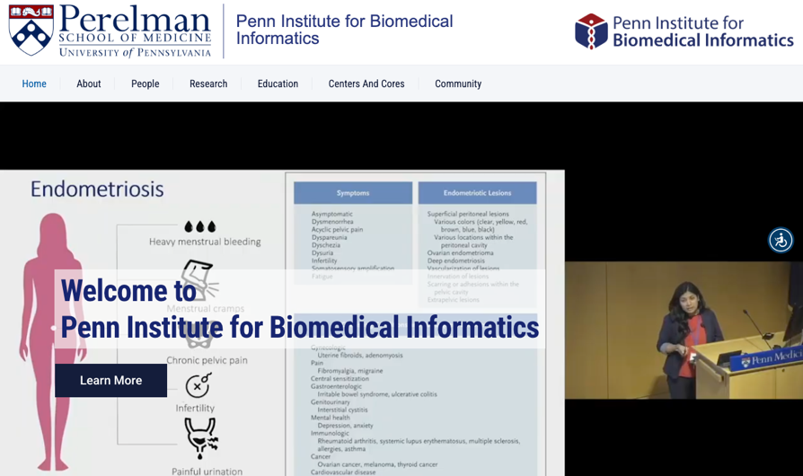
Penn Institute for Biomedical Informatics (IBI)
Director: Marylyn Ritchie
The IBI was established in 2015 to develop, advance, and support interdisciplinary education, research, and infrastructure in biomedical informatics including bioinformatics, clinical informatics, clinical research informatics, consumer health informatics, public health informatics, and translational bioinformatics.
AI2D Center (AI and Diagnostics)
Artificial Intelligence Collaboratory
Bioinformatics Core
Center for AI-Driven Translational Informatics
Center for Cancer Data Science
Center for Computational Biomedicine
Clinical Informatics Core
ibi.med.upenn.edu

Slide 11

IBI Bioinformatics Core
Director: Taehyong Kim
1. Data Analysis & Consultation
Professional bioinformatics services for Penn biomedical researchers
Expertise in study design, analysis, and interpretation
2. Next-Generation Sequencing (NGS) Pipelines
Development and use of efficient workflows for:
RNAseq
DNAseq
ChIPseq
Single-cell analyses
Integration of in-house pipelines with public tools and platforms
3. Faculty Expertise & Collaboration
Supported by IBI faculty specializing in:
NGS algorithm development
Human disease research (diabetes, cancer, autism, Alzheimer’s, etc.)
Functional genomics, statistical genetics, computational biology
4. Grant & Research Support
Assistance with grant applications: reviewing bioinformatics plans, ensuring rigor
Provision of computational resources and domain expertise across biomedical areas

Slide 12
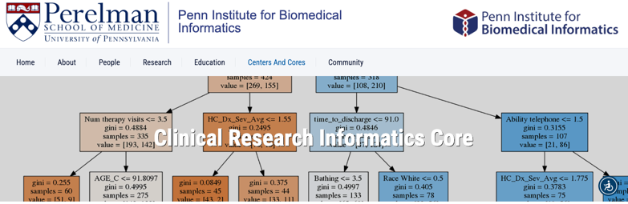
IBI Clinical Informatics Core
Director: Danielle Mowery
1. Clinical Data Access & Management
Support for secure and efficient access to Penn Medicine’s clinical data resources
Guidance on data governance and use for biomedical research
2. Advanced Analytics
Machine learning methods for clinical and translational studies
Natural language processing (NLP) to extract insights from unstructured clinical notes
3. Visualization & Interpretation
Data visualization services to support exploration and communication of findings
Custom dashboards and interactive tools for clinical research

Slide 13
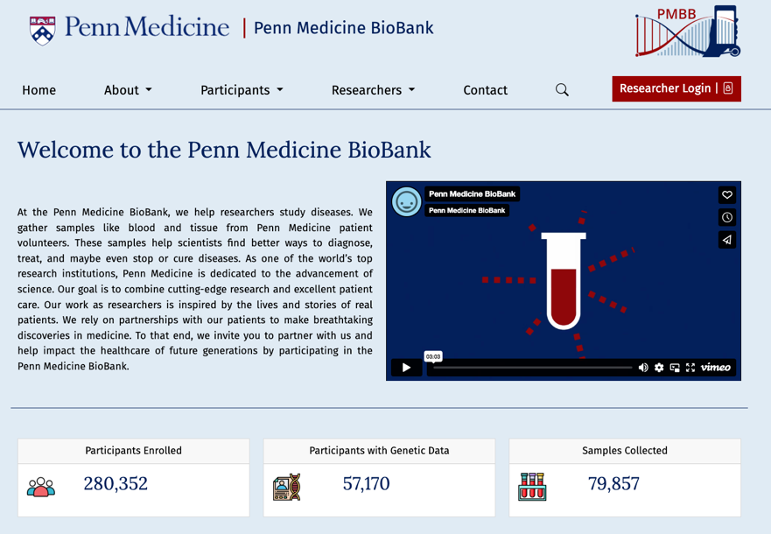
Penn Medicine BioBank (PMBB)
https://pmbb.med.upenn.edu/
Who can access the data?
Full-time faculty, adjunct faculty, staff, and trainees of the University of Pennsylvania with approved IRB protocols can submit an application to gain access to PMBB data or samples.
What types of data are available?
Genetic data (genotyping, whole-exome sequencing) are available on a subset of our PMBB participants. Clinical data from the EHR are available for all PMBB participants. Visit our genomic and phenotype data browsers to explore the types of data available.
How to access data?
Access to data is provided through the PMACS computing environment, via HPC or LPC servers. All users requiring access to data must have PMACS accounts. Once the steps outlined in the How to Access Data/Samples Page are completed and a study team has been granted approval for data, PMBB will grant authorized users with PMACS accounts access to the data via the appropriate server.

Slide 14
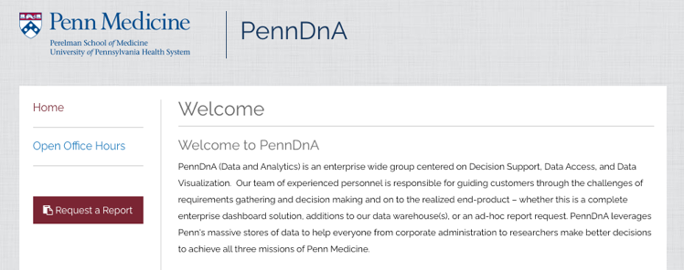

Other Clinical Data Computing Services
PennDnA (Data and Analytics): enterprise-wide group centered on Decision Support, Data Access, and Data Visualization.
Research Storefront: for clinical research scientists looking for self service tools to explore real world data with Penn privacy protections already in place.
TriNetX
Penn Network
Research Network
Linked Network
Slicer Dicer
PMBB – Pennn Medicine Biobank
IMRD – IQVIA Medical Records Database
Cosmos
https://www.med.upenn.edu/penndna/
https://uphsnet.uphs.upenn.edu/AnalyticsStorefront/Portals/research (UPHS Login and VPN needed)

Slide 15


Cloud Computing
Amazon Web Services (through University ISC)
AWS @ Penn - The AWS offering provides consolidated billing, account management, integration, operational and security controls, tools, and consulting for Amazon Web Services usage at Penn. The University-negotiated contract with AWS provides additional services and protections beyond what is available to individuals or organizations going directly to AWS.
Microsoft Azure (through Penn Medicine Information Service)
Penn Medicine has business agreement with Microsoft. Our medical data can be analyzed on Azure in a compliant environment. Developed infrastructure and workflows to manage, process and analyze research data from our health system.

Slide 16
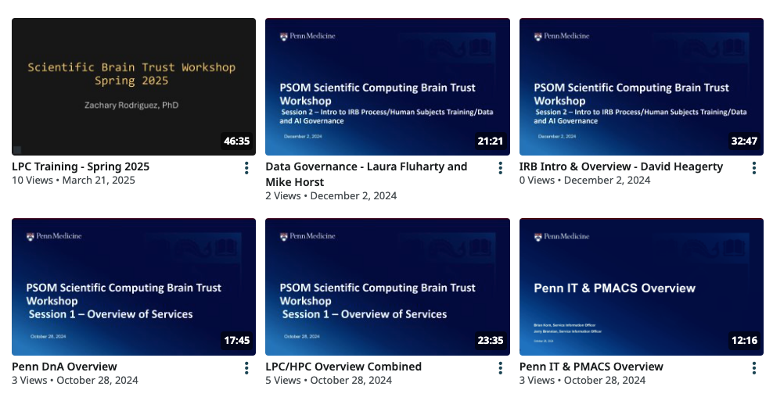
Scientific Computing Brain Trust
The Scientific Computing Brain Trust is a collaborative effort across Penn Medicine to educate faculty, trainees, and staff about existing people, processes, and platforms available to support clinical and translational research activities through an online video series.
Go to https://www.med.upenn.edu/pmacs/student and check the SCBT section.
The collaborative includes Penn Medicine Academic Computing Services (PMACS), Penn Data and Technology Solutions (DTS), Penn Data and Analytics Center of Excellence (PennDnA) with the Center for Clinical Epidemiology& Biostatistics (CCEB), Penn Medicine Biobank (PMBB), and the Institute for Biomedical Informatics (IBI).

Slide 17
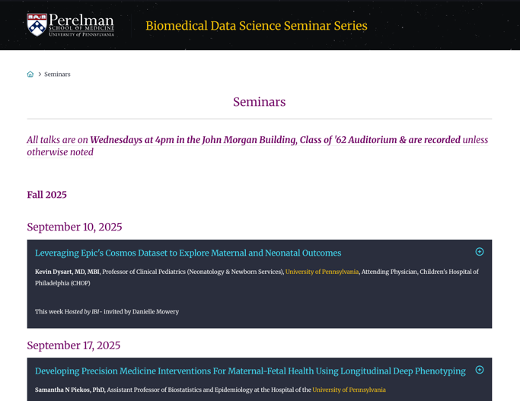
Weekly Biomedical Data Science Seminar Series
All talks are on Wednesdays at 4pm in the John Morgan Building, Class of '62 Auditorium & are recorded unless otherwise noted
Sample topics:
AI/ML methods (across imaging, genomics, EHR, trials, diagnostics)
Genomics & precision medicine (big data, diversity, causal inference)
Neuroscience & aging (Alzheimer’s, brain imaging, connectomics, neuro-immune)
Multi-omics biology (spatial proteomics, cancer, glioma, cellular heterogeneity)
Health data systems (ICU analytics, rare disease detection, governance)
https://www.med.upenn.edu/biomed-data-science-seminar/

Slide 18
Security and Compliance
Growing Importance of Data Security
Protect data privacy and uphold informed consent
Safeguard intellectual property
Maintain a secure computing environment
Extra Compliance for Sensitive Data
Human genetics & genomics
Electronic health records (EHRs)
Other personally identifiable information (PII)
Follow Policies & Best Practices
Respect data-use agreements (e.g., no sharing outside your project, no personal downloads)
Avoid risks from personal devices (USB, laptop, phone)
Install software cautiously – only from trusted sources
Stay vigilant against cyber threats:
Phishing emails
Ransomware
Social engineering attacks
Weak or reused passwords

Slide 19
If you have questions
PMACS
www.med.upenn.edu/pmacs/
Email: medhelp@pennmedicine.upenn.edu
Data and Technology Solutions Service Information Officers: PMACS_SIO@pennmedicine.upenn.edu
IBI
ibi.med.upenn.edu
Bioinformatics Core: https://bioinfo.med.upenn.edu/
Clinical Research Information Core: https://ibicic.med.upenn.edu/
Li-San Wang (lswang@pennmedicine.upenn.edu)

