Slide 1
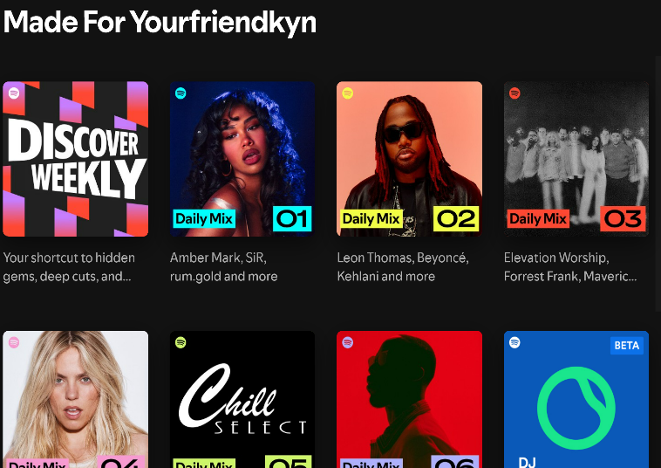
Making the Most of Graduate School: A Dance to the Playlist of Continuous Uncertainty
Kyndall Nicholas
6th year Neuroscience PhD Candidate
Notes:
Hello,
My name is Kyndall Nicholas and I am a 6th year phd candidate in the neuroscience program, also known as NGG. I will be sharing with you my PhD journey, some lessons I have learned, as well as opportunities that exist for you in this talk titled (read title). I have put a literal screenshot from my spotify to emphasize that this is MY journey and just how all over the place I am with my music to allude to how my PhD journey truly has been.

Slide 2
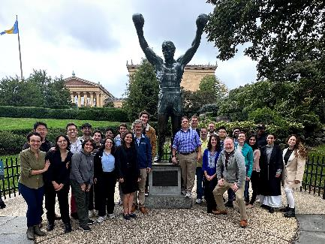
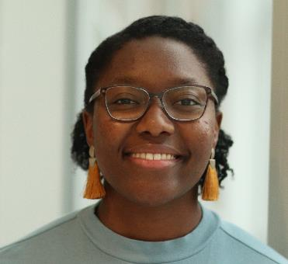
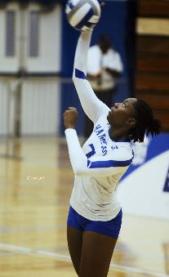
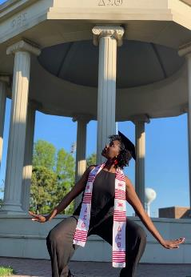
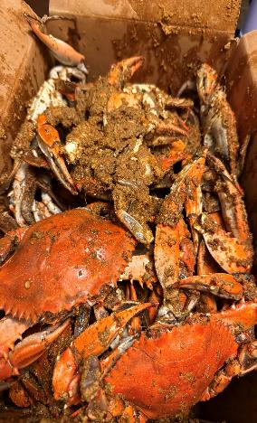

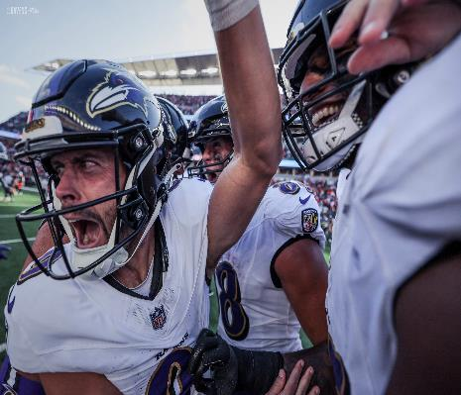
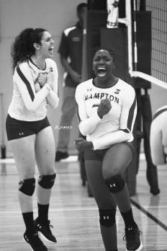
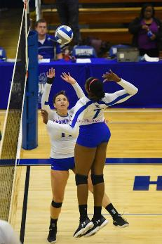
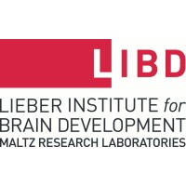
Notes:
So first off, a little background on me to give you context on this talk and my journey through my PhD. I was born and raised in Maryland and as Maryland as one can get. I got my bachelors in biochemistry with a inor in psychology from Hampton University and played division I volleyball. After graduating, I did NIH-PREP Program at Hopkins from 2019-2020 and now I am a 6th year PhD in Dr. Kacy Cullen’s lab studying how our everyday nutrition can potentially be protective against traumatic brain injury damage.

Slide 3
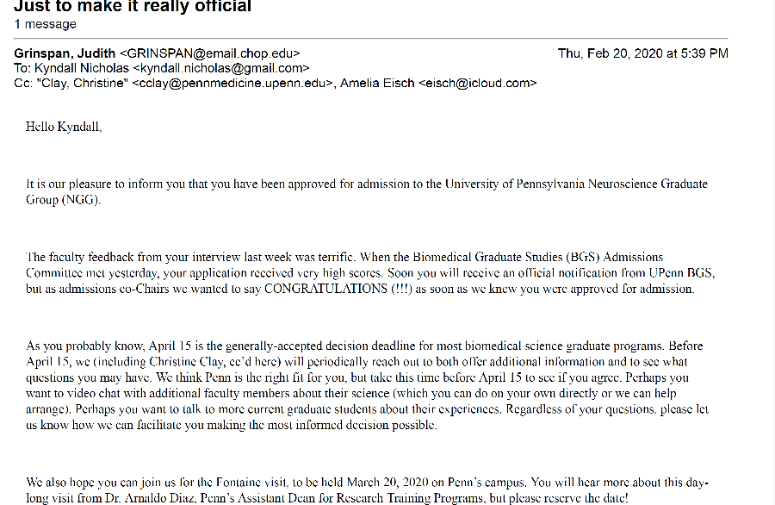
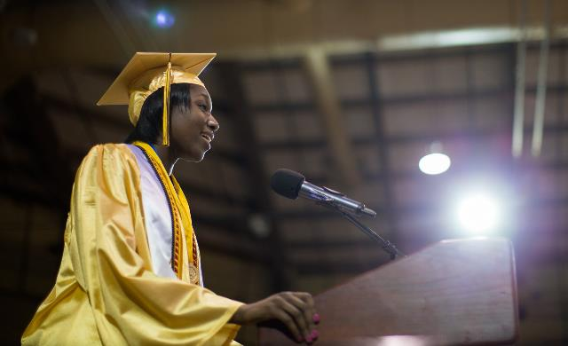
Notes:
The left is a picture from my high school valedictorian speech, where my teacher introduced me as wanting to get a PhD in neuroscience one day. Then I interviewed for Penn on my birthday and I then got a phone call from penn as I hopped on the Hopkins shuttle to go home. I was so excited that I saved a pdf version of my acceptance email to my hard drive. As you can see this is early 2020, so there was a ton of uncertainty of the future, but that did not dampen my excitement. I was ready to finally get my PhD in neuroscience.

Slide 4
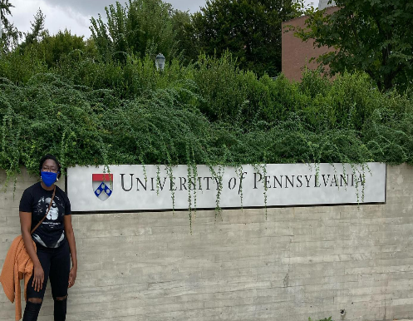

1st year: Excited to dance in a flash mob!
I am a suburban girl what is going on !!!!
Rotations (Dr. David Meaney, Dr. Kacy Cullen, Dr. Clementina Mesaros)
Classes (Cell 6000, Electrical Language of Cells, Systems Neuroscience, Journal Club, Theoretical Neuroscience)
Choosing a lab (Dr. Cullen with mentorship from Dr. Mesaros)– my project will be different from my rotation
Notes:
I came in ready to dance to the music with everyone. I saw it kind of like dancing in a flash mob. We would all take our classes, have a big community, and embark on this grand journey together. I was a suburban girl that was moving to the city and while that was absolutely crazy to me and navigating that was a journey. I knew that I wanted to come to Penn to study TBI, but because of covid, I chose to try first a computational lab that asked questions around TBI. I then chose a a large bioengineering lab to explore if I wanted to have a more innovative approach to my questions. Lastly, I tried a pharmacological lab that employed a technique that I wanted to use to answer the question in the second lab I rotated in.
- I ultimately paid attention to my mental health and my communication with the PI, how transparent I could be, and the techniques and research I would be doing. I chose the lab I am in because of the plethora of people to mentor me, the project, and my communication with the PI.

Slide 5
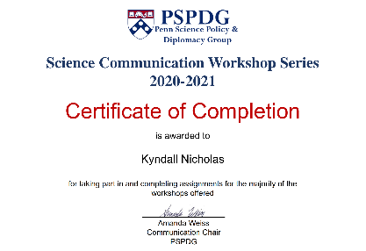
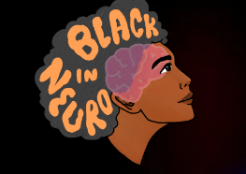
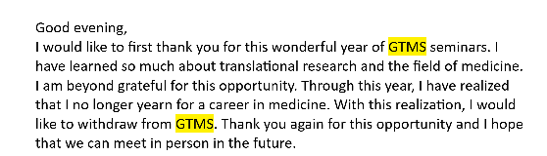
Completed PSPDG Science Communication Certificate
Left GTMS
Facilitated bonding for my cohort
Joined Black In Neuro Board
“Failed” Core II: Electrical Language of Cells
Made it through Cell 6000
Burned out and decided I was going to drop out
Notes:
Literally was just doing anything because I had no idea what the future of the world or science looked like (sounds familiar). Trying to navigate the virtual classes, lack of physical community, and rotation projects, I also organized a couple of events with my cohort trying to build community, took a role on helping to revamp the NGG website to be more accessible, and joined the board of Black In Neuro. I achieved a certificate in science communication through pspdg, a facilitator for action for cultural transformation, and peer counselor a part of the peer support network. I was reaching for community, but also trying to figure out if I had any career aspirations, because I had no clue what I wanted from a career as I left Graduate Training in Medical Science (GTMS) because I realized I didn’t want to be someone directly communicating with physicians like a MSL.
As for the virtual classes, I was failing my core classes for NGG (cos like what are y’all talking about right now), and doing just enough to pass cell 6000, because I was unmotivated. In our program we have the academic review committee and Josh Gold, the previous chair, was my POC. I emailed him after failing the second core class test and studying for the third test that I was absolutely burned out and could not do this anymore. He immediately met with me that evening. While our talk made me feel better about failing, I still wanted to drop out.

Slide 6
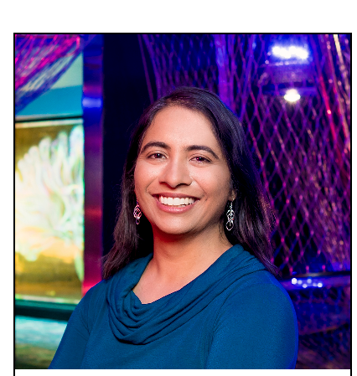
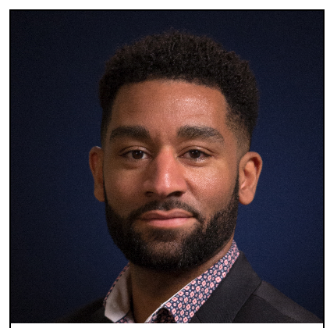
The Franklin Institute: Dr. Jayatri Das & Dr. Darryl Williams
Notes:
Planning my drop out plan, I started working out careers that I could do with what my interests and what I learned from the science communication workshops and my rotation experiences thus far. I knew I liked outreach, connecting with people, and science communication, so I got connected with Dr. Jayatri Das, and Dr. Darryl Williams at The Franklin Institute for informational interviews (take a moment to describe informational interviews). These conversations encouraged me to see if I could stay in the program and helped me think of my PhD as a means of opening doors for other people that cannot, while also encouraging me to find my why cos they weren’t hiring at the time cos like COVID duh. After choosing my lab, I took 6 weeks in between my first year and second year to figure out what I needed and get a well needed unplugging.

Slide 7
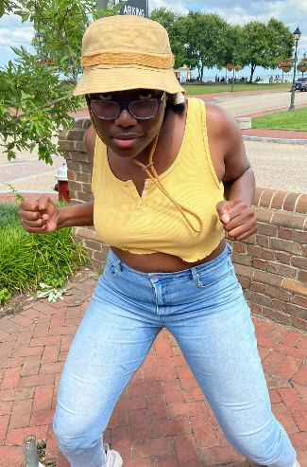
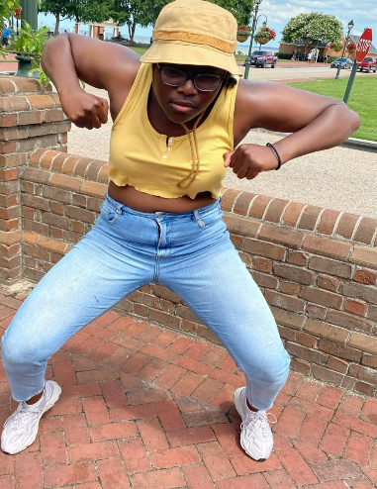
Lessons of 1st year: Everyone is doing their own dance, but to the same music, I think?
Build relationships, you never know who can be in your corner. PIs ARE NORMAL PEOPLE AND CAN HELP YOU TOO!
Don’t suffer alone, reach out.
It’s okay to cry… like really cry, but like I can do this????

Slide 8
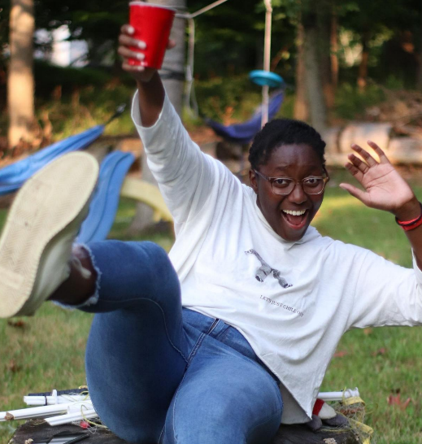
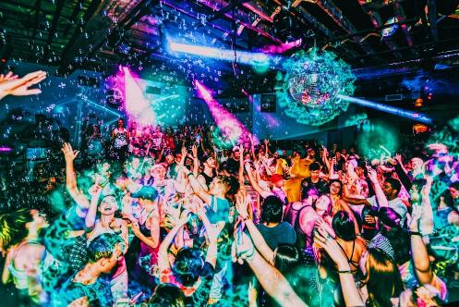
2nd year: Everyone is listening to their own music, but like at least we are all are dancing, am I right?
Candidacy exam preparation
Continued classes/ Independent Study
Leadership positions-Outreach Chair of EE JUST

Slide 9
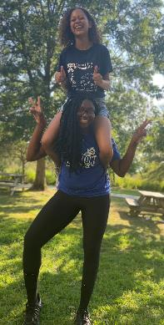
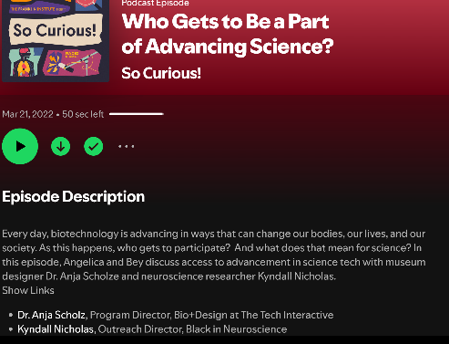
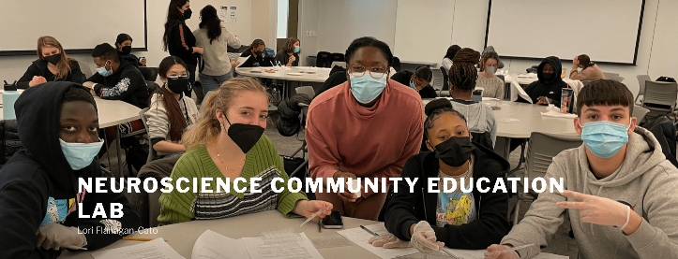

Community Engagement—Community Engaged STEM graduate certificate program
STEM Scholars
The Franklin Institute Podcast
Notes:
Simultaneously, I am taking classes again and for the first time in person and literally unable to figure out what time I should wake up to get to class. Knowing I liked outreach and that was currently a part of my “why” I was staying in my PhD. I reached out to Josh to see if he knew of anything that existed as a “class”. That is where I connected with Dr. Loretta Flanagan-Cato and my independent study for two semesters involved teaching science to high schoolers from a local high school in West Philly fundamental biological principles to help them on their state exams. I extended this opportunity to my SIB, Erin Purvis who worked with Lori to now create what is available to everyone here is the Community-Engaged STEM graduate certificate program.
A friend that I made that was defending encouraged me to become the outreach chair for EE Just for the following year. I said sure fine, I like outreach, I’m Black, and love community so why not. While trying to figure out what the heck I was going to do because like covid still exists, I’m not from Philly and all of the outreach that existed no longer does due to covid. I reached out the Jayatri remembering parts of our conversation to see if she had anything that we could do outreach in. This birthed the CRISPR in a BOX programming with their 10th graders and EE Just. I also got an opportunity to be on the TFI podcast, implementing what I learned from my science communication certificate.

Slide 10
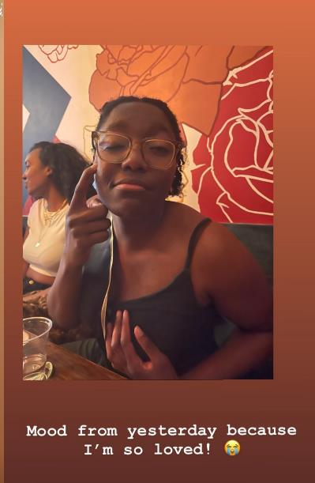
Candidacy Exam
I took four months to focus solely on my exam, no lab work
I partied with all of America
Took a week to reset cortisol
Notes:
While finishing my last bit of classes, my independent study, I completed my candidacy exam on Cinco de Mayo so that everyone else could celebrate with me too. Everyone needs something different during this time. Some people need to be in lab for distractions and motivation and some people like myself need to focus on that one thing. I spent 4 months preparing for the exam and actually did not come physically into lab much. I knew that is what I needed while meeting weekly with my PI and he respected it. Once I passed and celebrated, It was time to get to business.

Slide 11
Lessons of 2nd year: Okay, no it wasn’t the same music, but that’s okay I finally found the music I like and have curated the perfect playlist
Ask questions, you have no clue what exists out there
Therapy is amazing!! (shoutout to Penn’s insurance)
Celebrate hard!!
Focus on your journey and your needs
Notes:
I love community engagement and decided This is the career I want for myself, just going to do that and my research and I’ll be great.

Slide 12
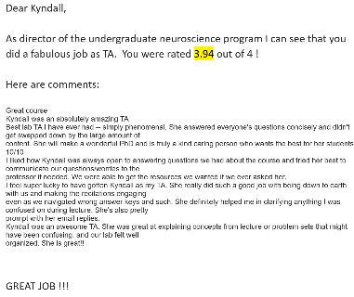

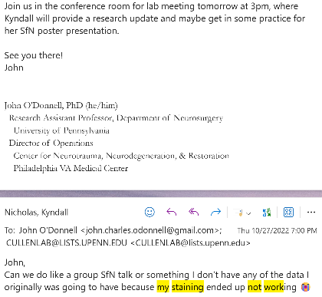
3rd year: whose playlist is this?
1st conference
Confusion, chaos, and failures
TAing
President of EE Just
Mentored my first undergrad
1st committee meeting
Applied for F31
Awarded HHMI Gilliam Fellowship
Got the opportunity to build a science exhibit
Notes:
I did my required TAing of intro to neuro, while drowning in failure of science, preparing to go to SfN, and being the president of EE JUST, learning administration of a school I don’t even know how to get around. Helped EE JUST build again after covid.
-- an advisory board, a website, merch, outreach programming, social programming, and a relationship with the student body and apprenticeship for longevity. I also mentored my first undergrad

Slide 13
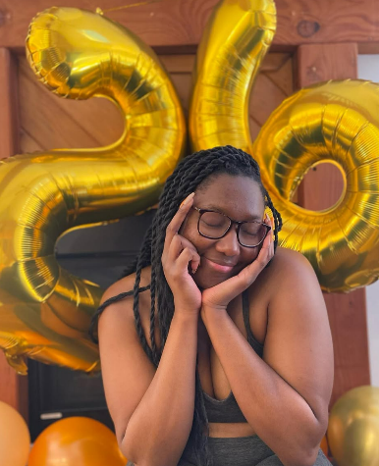
Lessons of 3rd year: Wow that was weird, but I at least like some of the songs, I think I can dance to them still
Focus on finding your why
Focus on building your community—family, friends, network, support system
It’s okay to change or be confused about what I like still
I am still a great scientist, I just like failed… A LOT! I am not above the third year slump.
Notes:
I knew I liked community engagement, but I wasn’t sure I wanted a career in it anymore. So now I know like community and science, but I don’t want to be a MSL, idk if I can do research, and don’t want to work at a nonprofit.
Third year is very tough and makes a lot of people question their scientific skills and ability to be a scientist with the constant failure. So community is so important here, especially when 3rd year is when cohorts start to break up a little more with no more mandatory joint classes to attend.

Slide 14
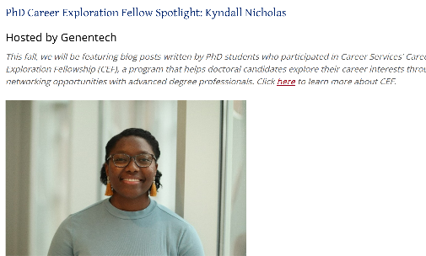
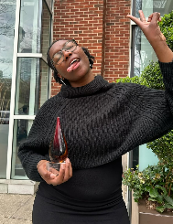

4th year: Okay, why did I think I could dance to this, I’d like to get back to my playlist please!
Recruitment chair
President of EE Just
CURF Fellowships Grad Fellow
CETLI Graduate Fellow
Continuous confusion
WOCAP
2nd committee meeting
Mentoring another undergrad
Academic Review Committee
Career Exploration Fellowship- Genentech
Career Paths Mentoring Program – Regulatory Affairs
Cycling Instructor
Notes:
I took this year to dig very deep in my career exploration bag-I knew I enjoyed teaching, leadership, and outreach, and people. I liked science, but unsure if I wanted to be the one that did it all the time. Took opportunities to follow those threads while continuously building my network. As you can see, I was determined to find something for me.

Slide 15
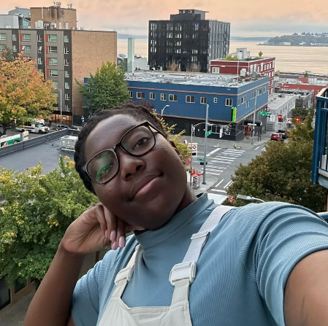
4th year: Okay this is just the playlist I am going to have to work with it.
Grounding myself in my growing community—do not isolate no matter how tempting it is
Seeking opportunities to learn about other career paths helps know what exist and how it works
Notes:
I truly left this year uncertain, but feeling like I might be able to find something for me. I also started to embrace the confusion that came with science more. With that I somewhat started to see my future as a career research scientist after learning about more that I did or did not want to do. Being in a PhD and failing in science is different as a tech, associate, or undergrad because each failure feels like a step further away from accomplishing the PhD. It gets hard to think of the science differently and science starts to not be science anymore. However learning about all the other jobs, I realized maybe science research is where I want to be, but again uncertain.

Slide 16
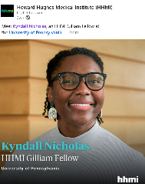
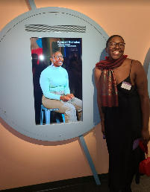

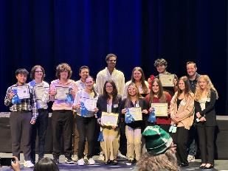
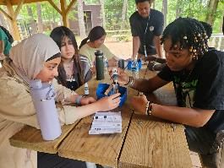
5th year and beyond: Okay I think I have figured out my dance to this music!
Seeing my exhibit come to fruition
Mentoring 2 more undergrads
Recruiting chair part 2
Volleyball Coach
Scholar Mentoring & Development Program- Biotech Scholar
Executing HHMI sponsored community engagement
Writing my first of 2 papers
International conference
Attending defenses
Notes:
I synthesized all I had learned about myself, careers, and the world. I stopped trying to make science work for my degree making me fall in love with it all over again with a different lens. I stopped trying to force a future and let the future come to me.

Slide 17
Overall lessons:
Everyone is just as confused as you no matter what front people like to put on
This truly is your own dance to a curated playlist “For You” and how you navigate it, is entirely on you
If I didn’t want to drop out and explore that, I would not have been on a podcast, curated an exhibit, created a program that still runs today and has successfully for the past 4 years, and created a lasting network.
It’s okay to be scared of making the wrong decision. It’s not about figuring out the perfect song, it’s about how you dance to the one that’s playing.
Notes:
Now here were are. Here are some of my overall lessons from my journey to pass on to you as you start your journey, no matter what stage of life you are in, your age, or your background.

Slide 18
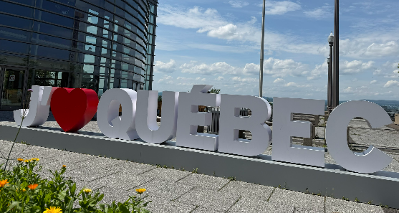
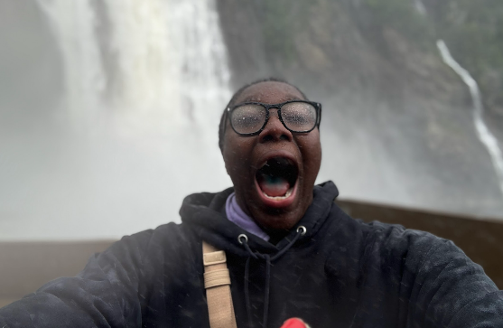
Personal approach to the future: Enjoy the different playlists curated for me and see how the dance goes
Post-Doc in Quebec
Work toward a career in R&D and science community engagement & communication
Notes:
I will be doing a 3 year post doc in Quebec in nutrition and Alzheimers refining my expertise in immuno-nutritional neuroscience. I still don’t know what I want to do, but I know I like doing the science, talking to people, connecting with community, mentoring and seek a career in industry or an academic adjacent institute in R&D and science community engagement.

Slide 19
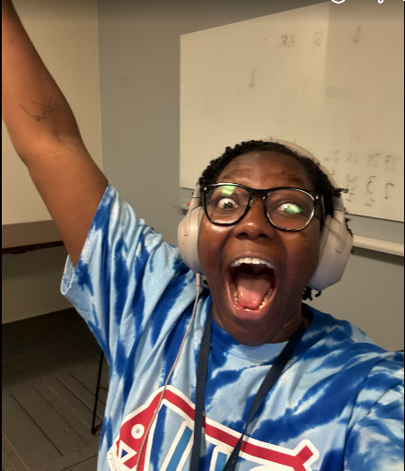
If you have any questions, feel free to reach out. I will literally meet with you and have friends in every program that can help you if not me.
kyndall@pennmedicine.upenn.edu
LinkedIn
YOU GOT THIS!! ENJOY THE SONGS OF YOUR PHD!
Notes:
If you have any questions about navigating Penn, Philly, your program, or any of the opportunities I listed here please feel free to reach out.

