Slide 1
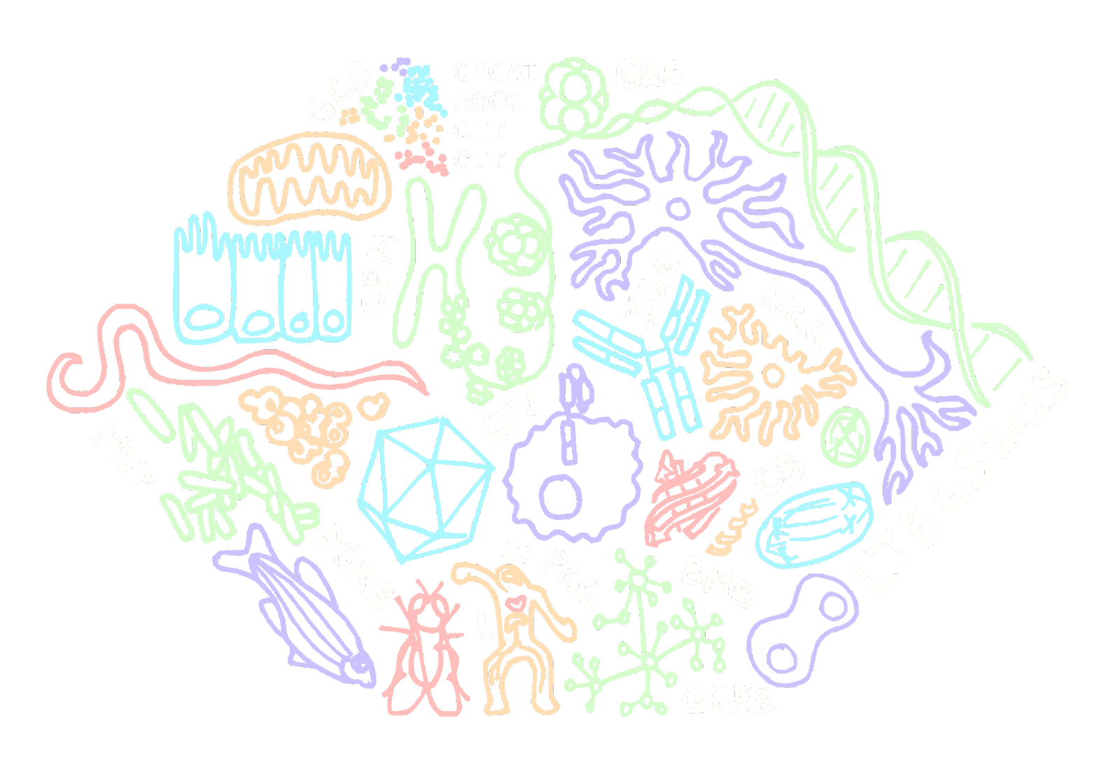
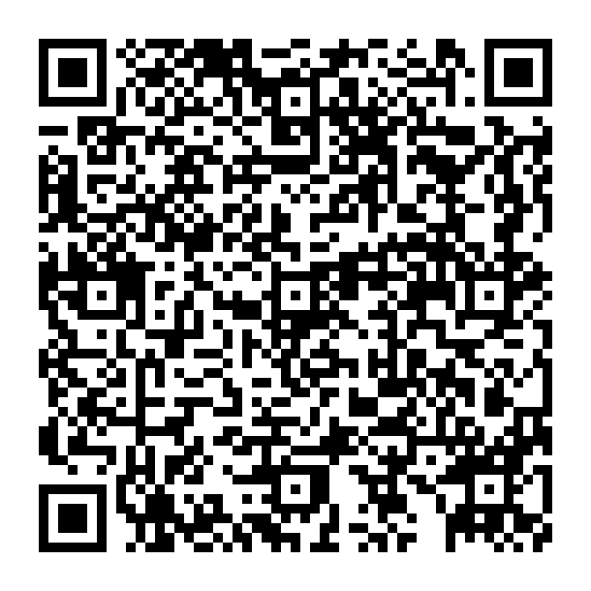
LTBGS @ Penn
A collection of queer and allied students at Penn
Run by BGS students with events geared towards generating community amongst queer students, post-docs, and faculty
Mission Statement
Collaborate with other minority groups to celebrate diversity and intersectionality;
Provide safe space for our community;
Development of members: professional and academic.
Want to join our Slack?
Some previous and recurring events
Queer in STEMinar series
Friendsgiving
Queer Jeopardy
Self-care Week

