Slide 1
Community-Engaged STEM Certificate Program
Lori Flanagan-Cato, PhD
Certificate Director

Slide 2
A university-wide graduate certificate
Why?
The scientific community has a responsibility to the broad spectrum of our society for better access to basic STEM and biomedical advances.
How?
This educational program invests in students the skills needed to collaborate with community partners, especially underserved groups, to improve science and biomedical literacy.
Who?
The program is led by a team of community-engaged faculty advisors, including UPENN clinicians and basic scientists.

Slide 3
Certificate Requirements: Four components
Courses
Community Engagement
Seminar Participation
Capstone Project

Slide 4
Milestones
1.
2.
Participation in the Bridging the Gaps program heavily overlaps with requirements for Penn’s graduate certificate in Community-Engaged STEM.
Coursework:
1) Biomedical Research in the Urban Curriculum.
2) Elective.
Engagement: Forty hours of mentored work in the community.
3.
4.
Research Seminar: Mondays each month at noon, lunch provided.
Capstone Project: Independent work that moves community-engaged STEM initiatives forward.

Slide 5
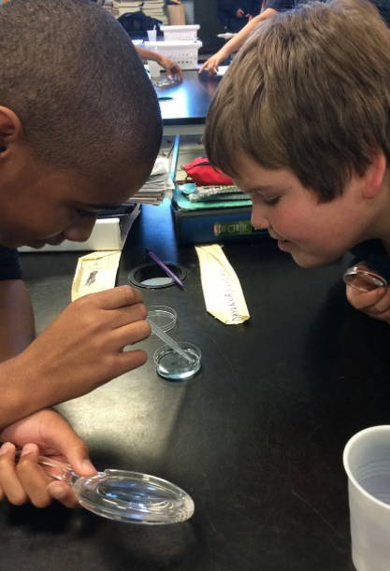
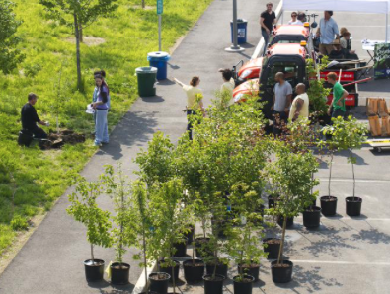
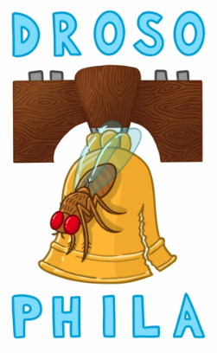
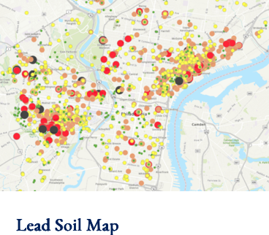
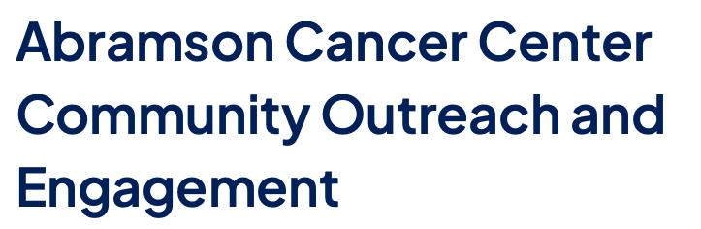
Examples: Education, Health, Environment

Slide 6
Key Points
Opportunity to network with students, physicians and scientists driven to serve the broader community.
Certification goes on your Penn transcript.
Deepen your connection with Philadelphia.

Slide 7
Questions?
Email Lori Flanagan-Cato flanagan@psych.upenn.edu
Program website to register for certificate, schedule of upcoming seminars: https://www.med.upenn.edu/cescp/

