Slide 1
Perelman School of Medicine University of Pennsylvania
Biomedical Research Cores
August 21, 2024

Slide 2

Core Facilities Mission Statement
PSOM core facilities provide state-of-the-art services that allow scientists to conduct innovative research utilizing resources for which cost, operational investment and expertise is most efficiently supported as a shared resource. Cores’ valuable equipment, scientific knowledge and technical guidance are accessible to a range of researchers.

Slide 3

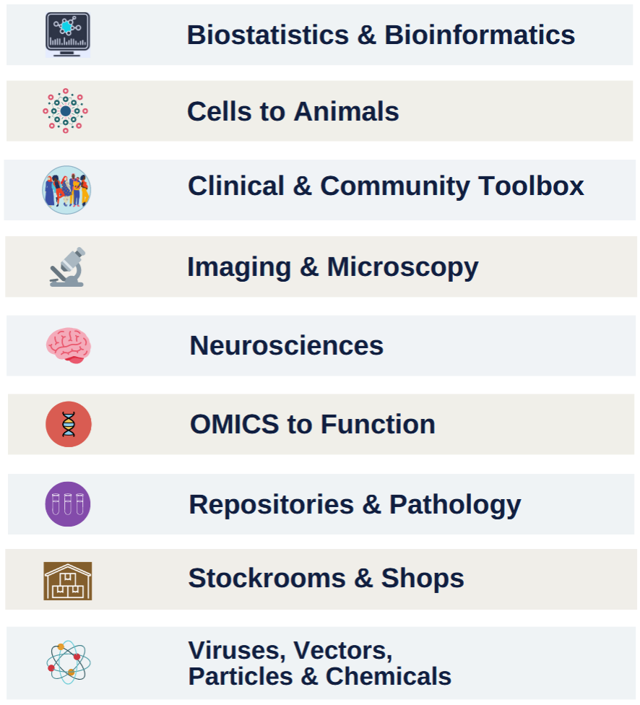
PSOM Biomedical Research Core Facilities
70+ core facilities spanning multiple domains:

Slide 4

Biostatistics & Bioinformatics
Immune health platforms
Itmat bioinformatics facility
Itmat study design & biostatistics core facility
Ldi health economics data analyst pool (Wharton)
Ldi health services research data center (Wharton)
Mixed methods research lab
Neuroimaging & cognitive core facility
Penn genomic & sequencing core: molecular profiling facility
Viral molecular high density sequencing core facility
Bioinformatics Core Facility
Biostatistics analysis center
Center for advanced metabolic imaging in precision medicine (camipm)
Center for biomedical image computing & analysis
Center for biomedical informatics core (bmic)
Center for preventive ophthalmology & biostatistics (Cpob)
Cluster for biomedical image computing
Human immunology core Facility
Ibi clinical research informatics core Facility

Slide 5

Cells to
Animals
Animal biosafety level 3 core facility (Absl-3)
Animal model core facility: penn vet new bolton center
Cell & animal radiation core facility
Cell center services facility
Comparative pathology core facility: penn vet
Crispr cas9 mouse targeting core facility
Drc radioimmunoassay & biomarkers core facility
Engineered Mrna & targeted nanomedicine core facility
Flow cytometry core facility: penn dental
Gnotobiotic mouse core facility
Human immunology core facility
Ifi cytof service center
Imaging core facility: penn vet
Induced pluripotent stem cell core facility
Islet cell biology core facility
Microbial culture & metabolomics core facility
Penn cytomics: flow cytometry & cell sorting core facility
Penn vector core facility
Rodent cardiovascular phenotyping core facility
Rodent metabolomic phenotyping core facility
Small animal imaging facility
Stem cell & xenograft core facility
Transgenic & chimeric Mouse core facility
Transgenic & chimeric mouse core facility: Penn vet

Slide 6
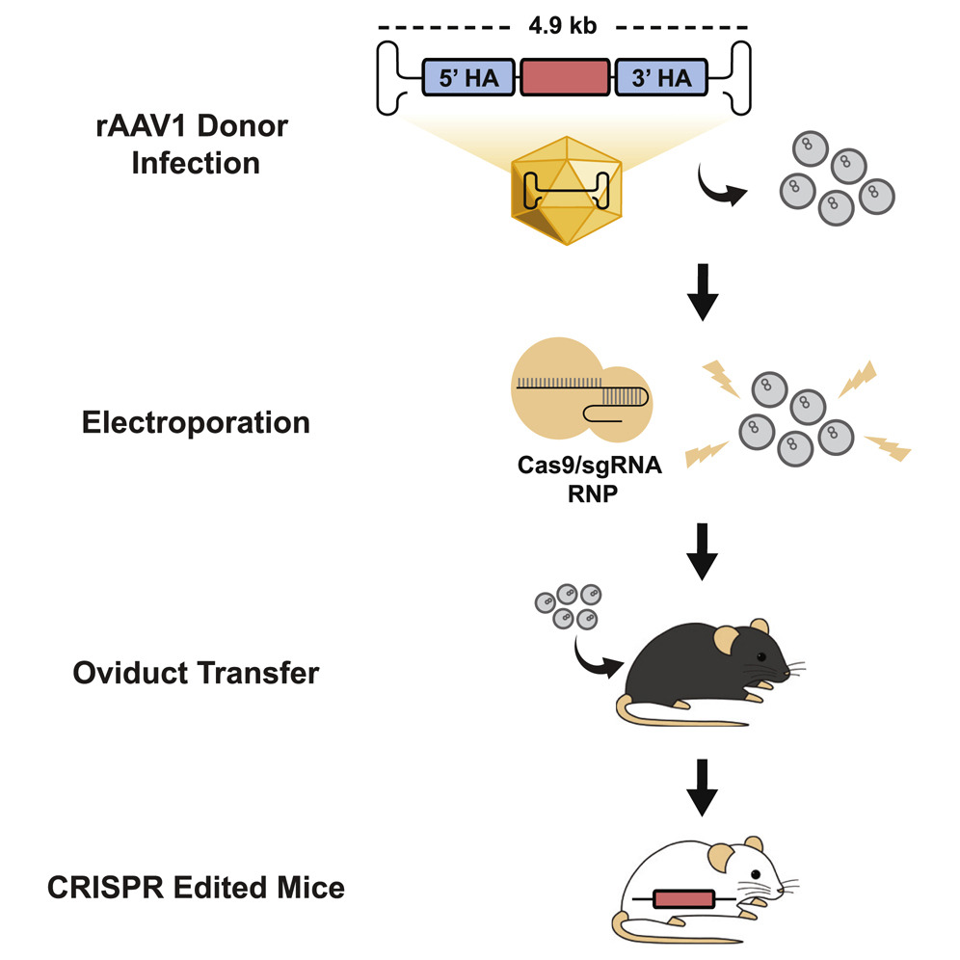
Cells to
Animals
Highlight:
The Transgenic and Chimeric Mouse Facility in conjunction with the CRISPR/Cas9 Mouse Targeting Core offer advanced technologies in mouse genome editing.
Introducing CRISPR-READI
An efficient method of generating knock-in mice
by AAV donor infection and CRISPR-RNP electroporation.
Enables complex genome engineering by homology directed
repair with donor lengths up to 4.5 Kb.

Slide 7

Clinical & Community Toolbox
Biostatistics analysis center
Community engagement & research core facility (cear)
Center for advanced computer tomography imaging services
Center for advanced mri & spectrometry
Center for human phenomic science
Center for preventive ophthalmology & biostatistics
Clinical research collaboration unit
Electronic phenotyping resource (epr)
Human immunology core facility
Human intervention core facility
Ibi clinical research informatics core facility
Immune health platforms
Mixed methods research lab
Neuroimaging & cognitive core (nicc)
Pet center
Referral center for animal models of human genetic disease: penn vet
Viral molecular high density sequencing core facility

Slide 8

Imaging & Microscopy
Cdb microscopy core facility
Center for advanced metabolic imaging in precision medicine (camipm)
Center for biomedical image computing & analytics
Clinical imaging core facility service center
Cluster for biomedical image computing
Comparative pathology core facility: penn vet
Electron microscopy resource lab
Imaging core facility: penn vet
Live cell imaging core: Penn dental
Molecular pathology & imaging core facility (mpic)
Neuroimaging & cognitive core (nicc)
Pet center
Tissue processing laboratory: penn dental
Ultrasound research laboratory

Slide 9

Neurosciences
Brain science service center
Imaging core facility: penn vet
Neurobehavior testing core facility
Neuroimaging & cognitive core facility

Slide 10

Omics to Function
Center for host-microbial interactions: Penn vet
High-throughput screening core facilIty
Human immunology core facility
Imaging core facility: penn vet
Johnson foundation biophysical & structural biology core facility
Metabolomics core facility
Microbial culture & metabolomics core facility
Neuroimaging & cognitive core facility
Penn genomic & sequencing core: dna sequencing facility
Penn genomic & sequencing core: molecular profiling Facility
Penn genomic & sequencing core: next generation sequencing core
Proteomics core facility
Viral molecular High Density Sequencing Core Facility

Slide 11

Repositories & Pathology
Center for host-microbial interactions: Penn vet
High-throughput screening core facility
Human immunology core facility
Imaging core facility: penn vet
Johnson foundation biophysical & structural biology core facility
Metabolomics core facility
Microbial culture & metabolomics core facility
Neuroimaging & cognitive core facility
Penn genomic & sequencing core: dna sequencing facility
Penn genomic & sequencing core: molecular profiling Facility
Penn genomic & sequencing core: next generation sequencing core
Proteomics core facility
Viral molecular High Density Sequencing Core Facility

Slide 12

Stockrooms & Shops
Cell Center stockroom
MINS Machine shop
Nuclear medicine physics & instrumentation group
Penn electronic design shop
Research instrumentation shop

Slide 13

Viruses, Vectors, Particles & Chemicals
Cfar virus & Reservoirs Core Facility
Engineered mrna & targeted nanomedicine core facility
Extracellular vesicle core facility: Penn Vet
Penn Cytomics: Flow Cytometry & cell sorting core facility
Penn vector core facility
Targeting core facility

Slide 14
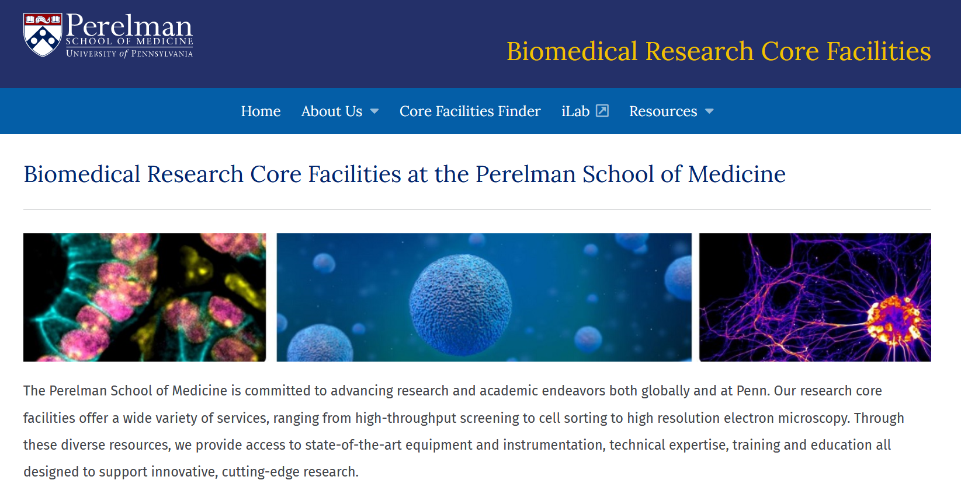
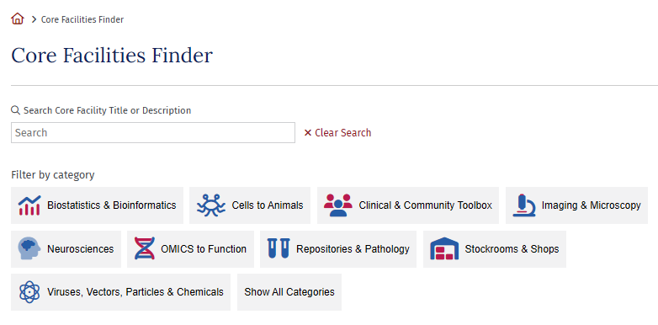
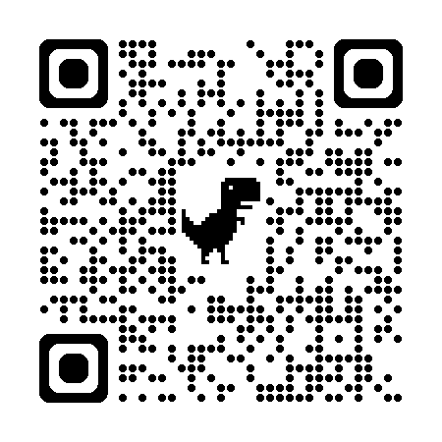
Visit our website to search for cores & learn more!
www.med.upenn.edu/cores
14

Slide 15
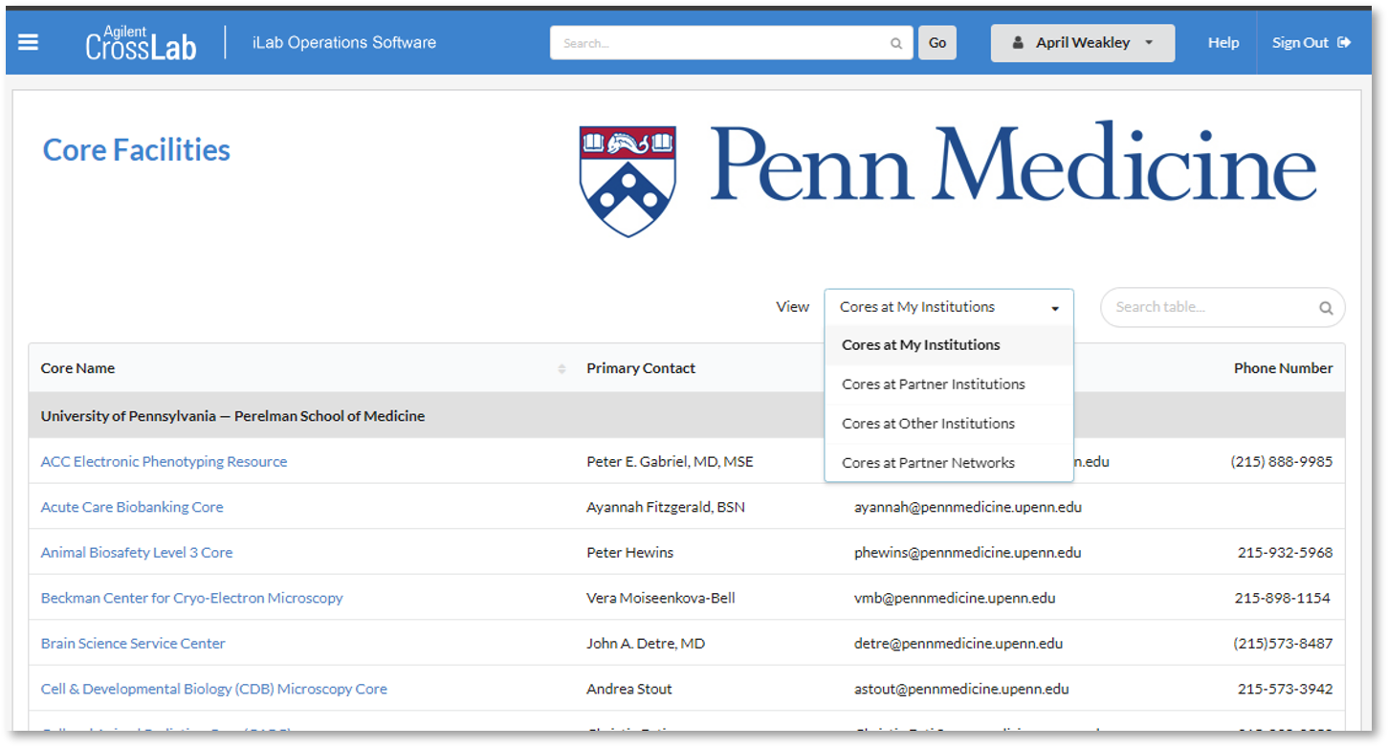
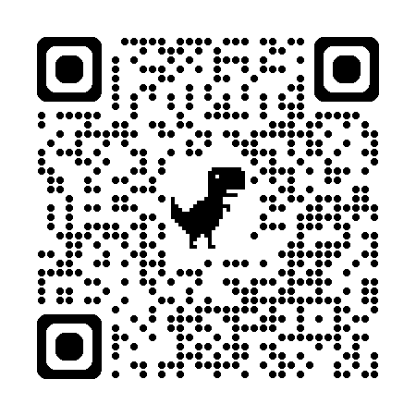
iLab
QUICKLY LOCATE CORES & REQUEST SERVICES
USED BY PENN, CHOP, WISTAR AND 215+ ORGANIZATIONS WORLDWIDE
KEEPS TRACK OF YOUR SERVICE REQUESTS, PROJECT STATUSES, & FINANCIAL APPROVALS
CONTACT ILAB.SUPPORT@PENNMEDICINE.UPENN.EDU TO LEARN MORE!
https://med-upenn.corefacilities.org
https://med-upenn.corefacilities.org/landing/264

Slide 16
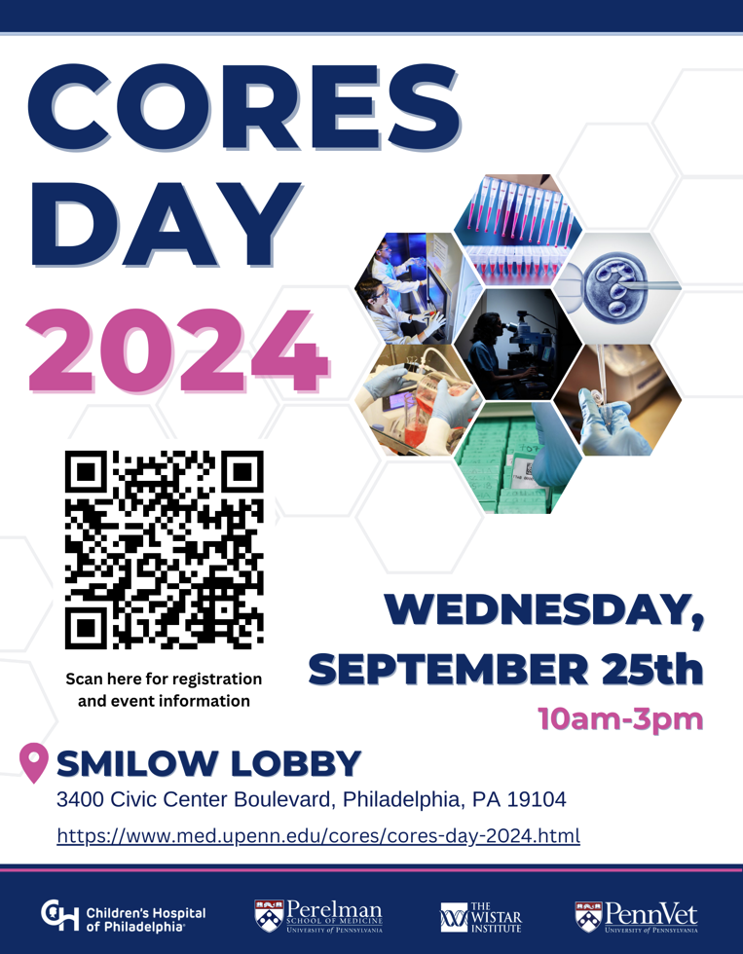
-Event showcases the many outstanding research resources/services available on campus
-Interact with 70+ core facilities spanning Penn, CHOP, & Wistar via informational tables staffed by core facility personnel
Registration is now open!

Slide 17


Questions?

