Slide 1

Penn Graduate Consulting Club
www.penngradconsulting.com

Slide 2

Who are we?
We are a student–run consulting club for non-MBA graduate students and post-docs.
We serve all graduate schools and postdoctoral communities, outside of Wharton:
Professional and academic Master’s students
PhD students and candidates at all schools
Professional doctoral students: JDs, MDs, DMD etc.
Postdoc fellows (each institute has their own organization, e.g. BPP at PSOM)
700+
Community Members
12
Our Mission?
Penn Schools represented
Educate Penn’s grad student and postdoc communities about the consulting industry
Prepare Penn’s advanced degree candidates (ADCs) for a successful career in consulting

Slide 3

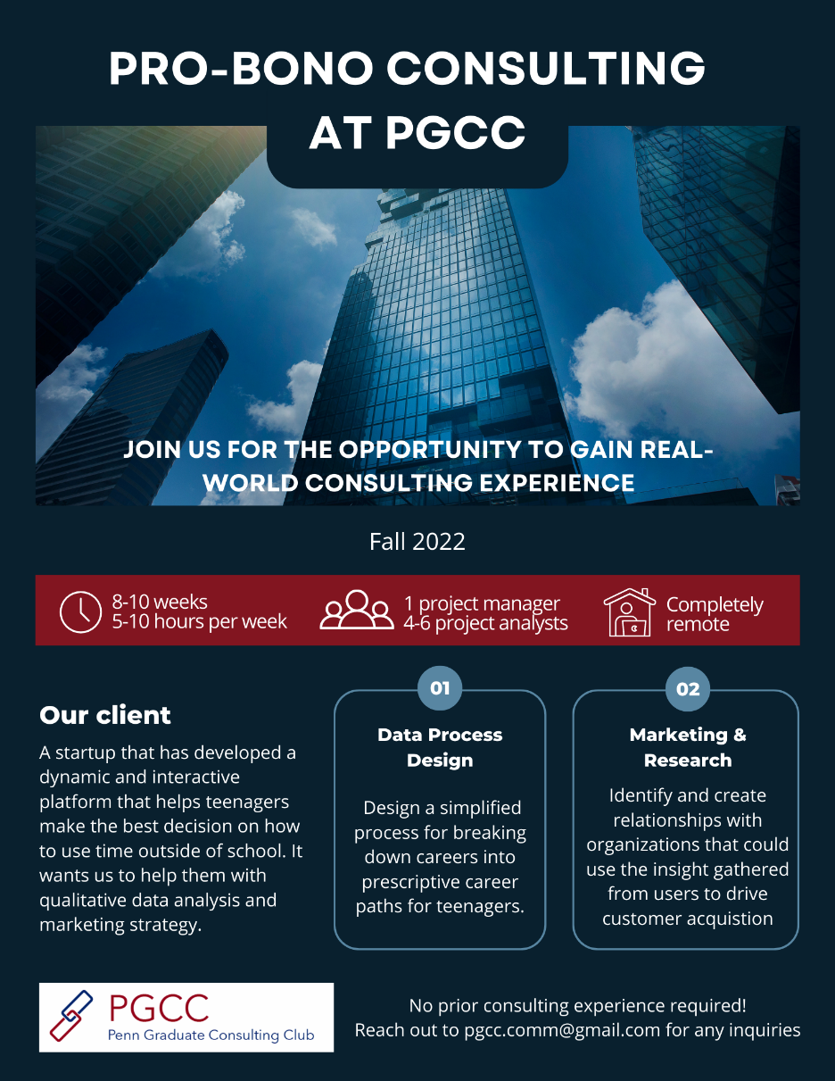

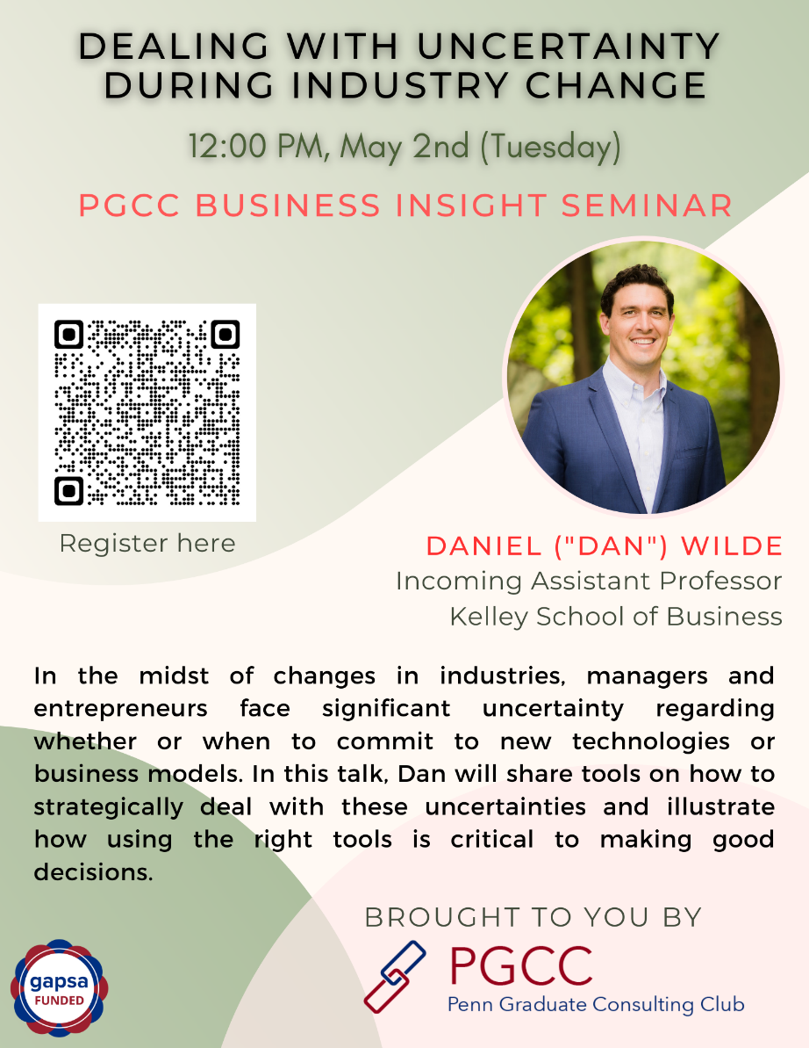
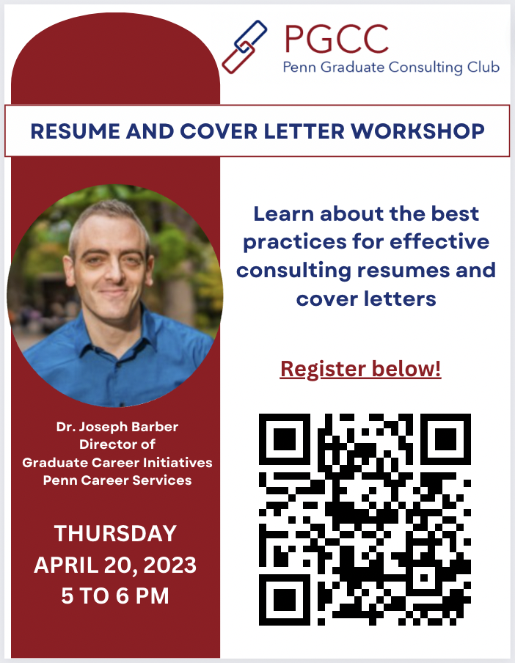
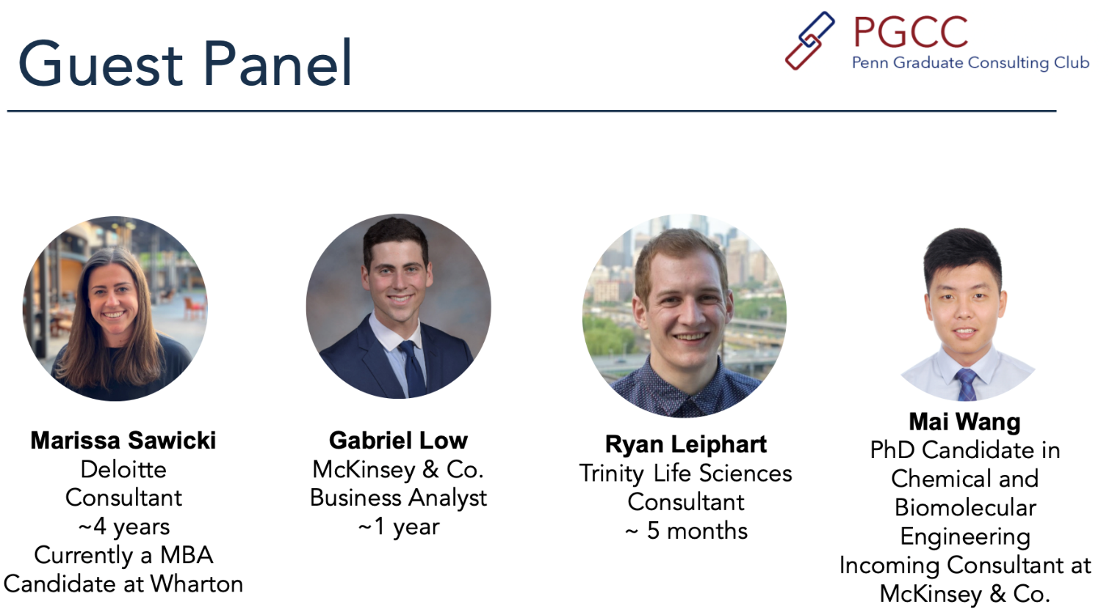
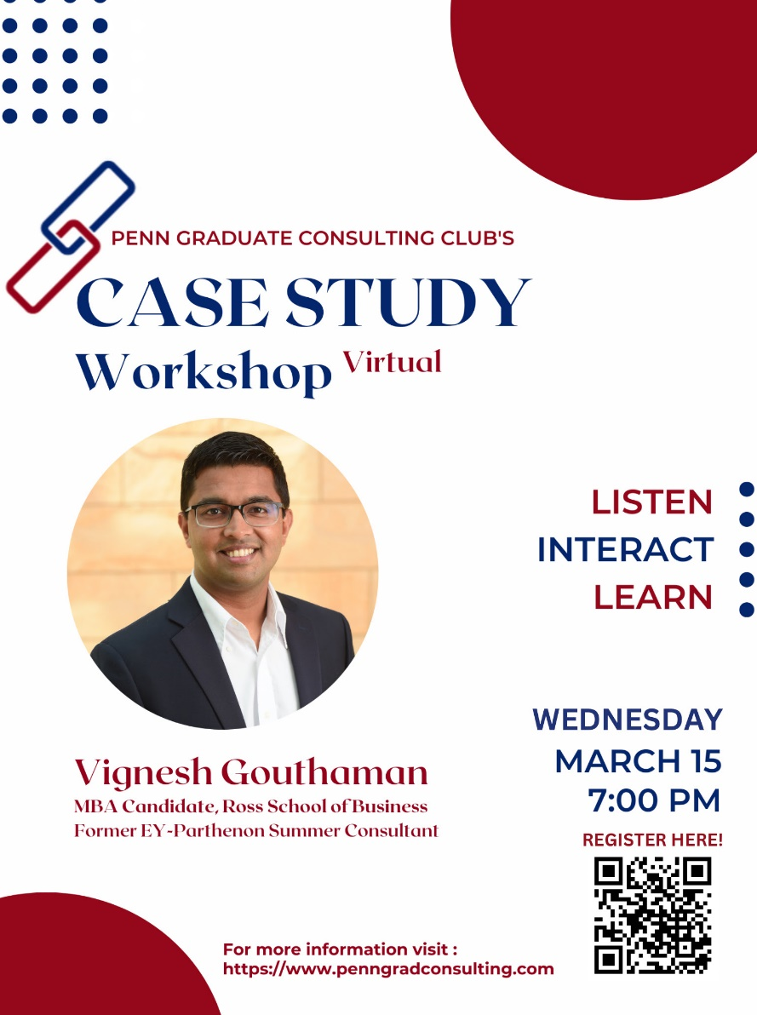
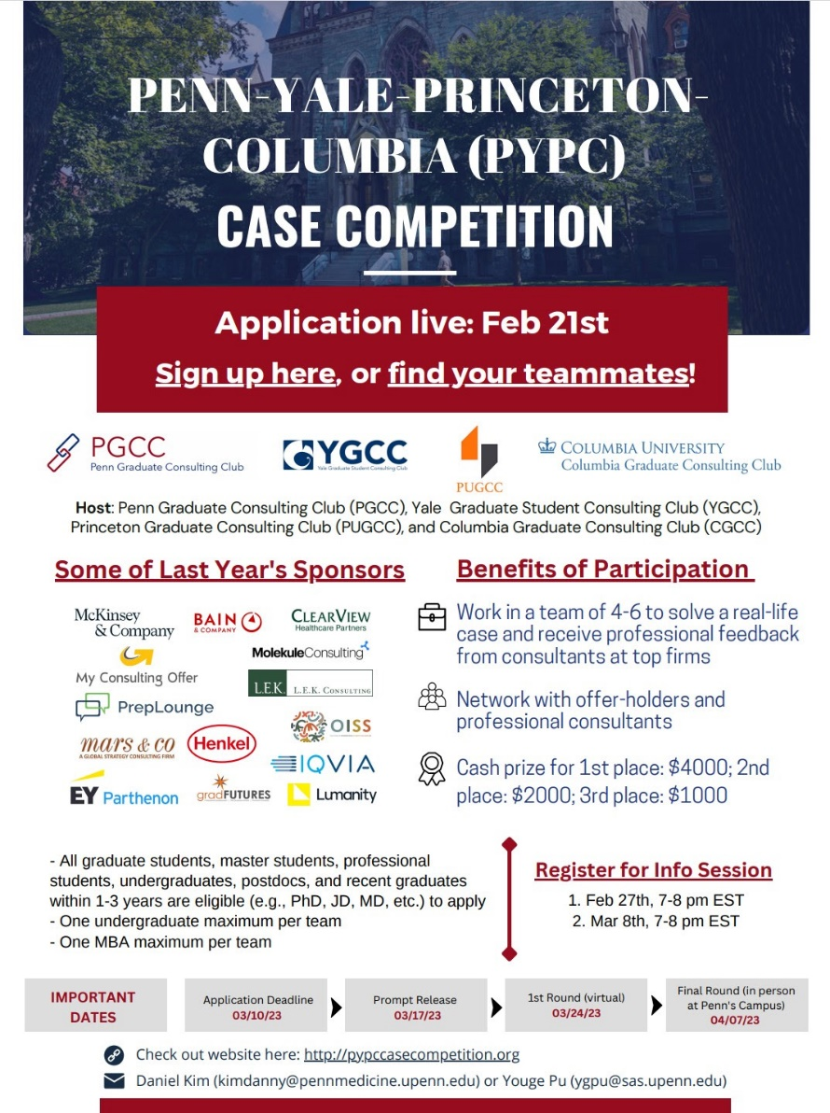
PGCC supports you through every step toward consulting
Discover Consulting
Hands-On Projects
Connect & Explore
Portfolio Building
Case Mastery
🎉
CONSULTING
Intro to consulting
Determine your fit
Deep dive into the industry's dynamics
Engage with clients to solve real-world problem
Develop soft skills needed for consulting
Exclusive networking events with alumni, current consultants, and recruiters
Deep dive into different consulting firm cultures
Hands-on resume and cover letter workshops
Collaboration with Career Service for personalized guidance
Comprehensive case interview preparation sessions
National casing network for you to find case partners
Case competition and casebook competition to showcase your skills

Slide 4

This year!!
📢
We are bringing in more…
Discover Consulting
Hands-On Projects
Connect & Explore
Portfolio Building
Case Mastery
🎉
CONSULTING
PGCC Exclusive Workshops with MCO
6 Pro Bono Projects from 4 different industries
PGCC Exclusive Career Fair
PGCC Casebook Writing Competition
Industry Dive
PYPC Case Competition
And much more!

Slide 5


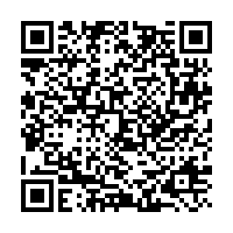







Join us!
Join our Virtual Kick-Off Event on August 30th from 6 - 7:00PM
RSVP for Happy Hour @ 7:30-9:30 PM immediately after!
7:30-9:30PM
RSVP!
Scan to Register
Subscribe to the mailing list
https://www.penngradconsulting.com/#get-involved
@upenn_pgcc
Landmark Americana
(3333 Market St)
Check out our
@PennGradConsulting
@Penn Graduate Consulting Club
pgcc.comm@gmail.com

Slide 6
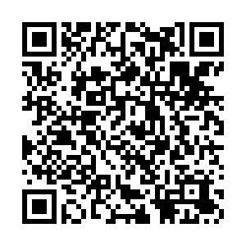
PGCC Membership
Scan the QR code to become a member now! This membership guarantees you access to exclusive members-only events and is also mandatory for pro bono project applications.

