Slide 1
Certificate Program in Environmental Health Sciences
Trevor M. Penning, PhD
Environmental Health Sciences Core Center: P30 ES013508-19
Translational Research Training Program in Environmental Health Sciences: T32 ES019851-13
http://ceet.upenn.edu/

Slide 2
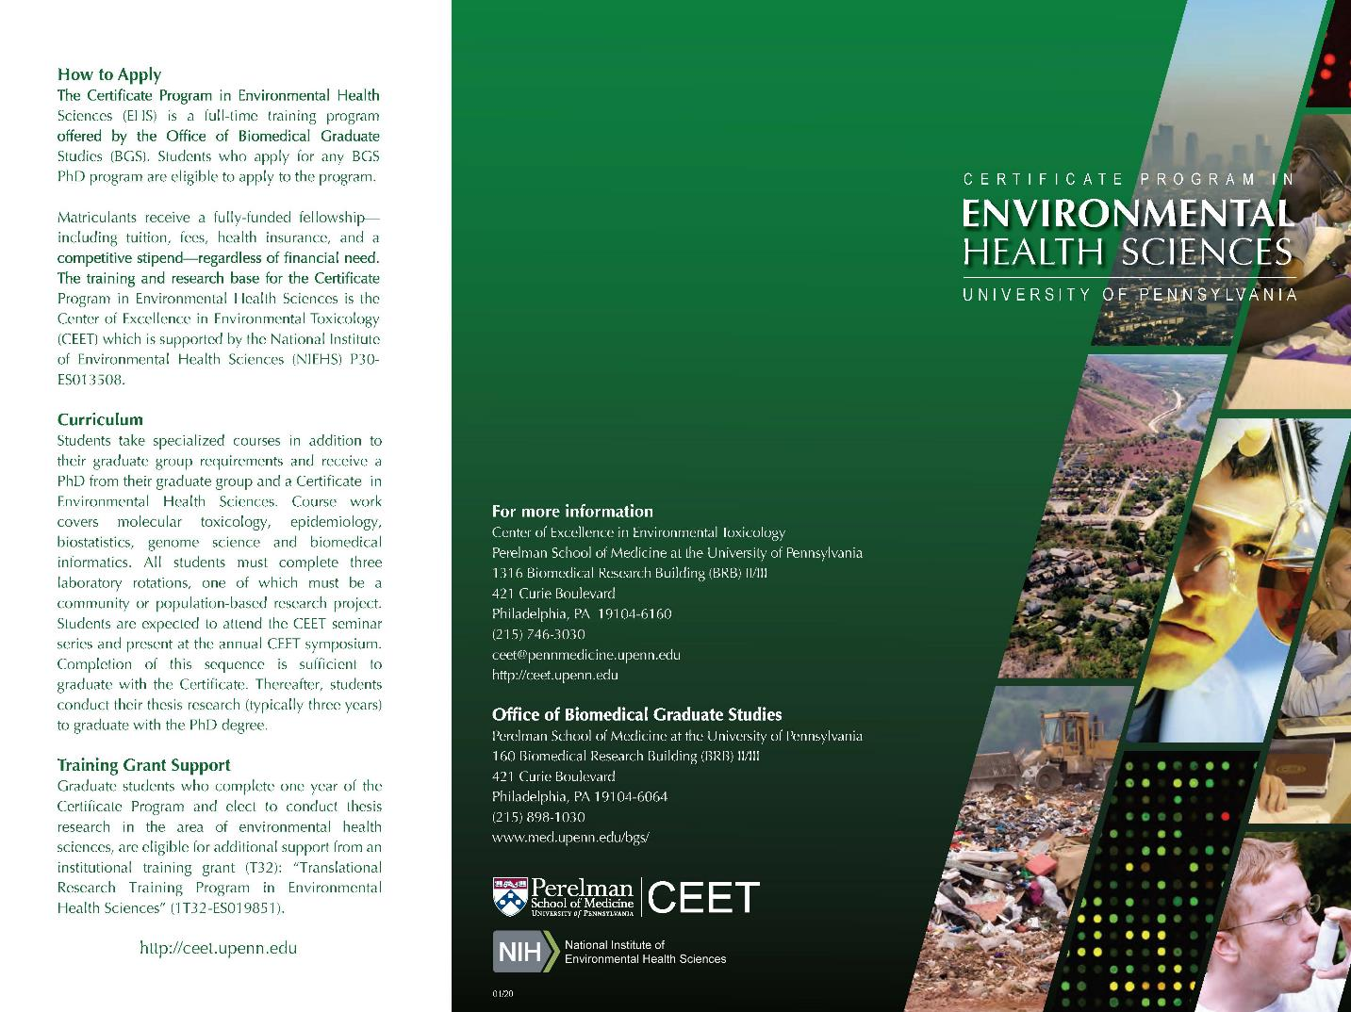

Slide 3
Center of Excellence in Environmental Toxicology (CEET)
Communities
Policy Makers
Health Care Professionals
(CEC)
Exposures
(Exposome
Climate
Change)
Implementation Science
Adverse Outcome
Translation
Patients
Human Subjects
(TRSC)

Slide 4
Center of Excellence in Environmental Toxicology (CEET)
Communities
Policy Makers
Health Care Professionals
(CEC)
Exposures
(Exposome
Climate
Change)
Implementation Science
Adverse Outcome
Translation
Patients
Human Subjects
(TRSC)

Slide 5
Center of Excellence in Environmental Toxicology (CEET)
L
Communities
Policy Makers
Health Care Professionals
(CEC)
Exposures
(Exposome
Climate
Change)
Implementation Science
Adverse Outcome
Translation
Patients
Human Subjects
(TRSC)
Thematic Areas
Air Pollution & Lung Health
Environmental Exposures & Cancer
Windows-of-Susceptibility
Environmental Neuroscience

Slide 6
Center of Excellence in Environmental Toxicology (CEET)
L
Communities
Policy Makers
Health Care Professionals
(CEC)
Exposures
(Exposome
Climate
Change)
Implementation Science
Adverse Outcome
Translation
Patients
Human Subjects
(TRSC)
Thematic Areas
Air Pollution & Lung Health
Environmental Exposures & Cancer
Windows-of-Susceptibility
Environmental Neuroscience
Cores
Biomolecular Mass Spectrometry Core (BMSC)
Environmental Health Informatics Core (EHIC)
Administrative Core (AC)-Career Development Program

Slide 7
Adverse Outcome Network Framework
Activation/
Detoxication
Metabolism
Disposition
Elimination
Excretion
Organ
Response
Organ Injury
Aberrant repair
Reprod/Develop
Disrupted
homeostasis
Molecular
Interactions
Molecular
Initiating Event
Receptor-Ligand
Binding
Protein Binding
DNA Damage &
Repair
Cellular Response
Key-Events
Genomic/
Epigenomic
Proteomic/
Metabolomic
Altered Signaling
Interactome
Toxicant
Outcome

Slide 8
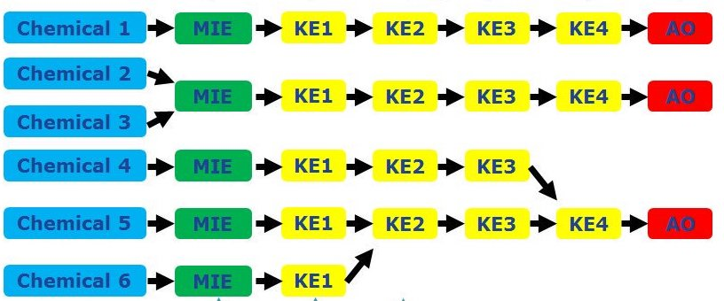
Adverse Outcome Network Framework
Activation/
Detoxication
Metabolism
Disposition
Elimination
Excretion
Organ
Response
Organ Injury
Aberrant repair
Reprod/Develop
Disrupted
homeostasis
Molecular
Interactions
Molecular
Initiating Event
Receptor-Ligand
Binding
Protein Binding
DNA Damage &
Repair
Cellular Response
Key-Events
Genomic/
Epigenomic
Proteomic/
Metabolomic
Altered Signaling
Interactome
Toxicant
Outcome

Slide 9
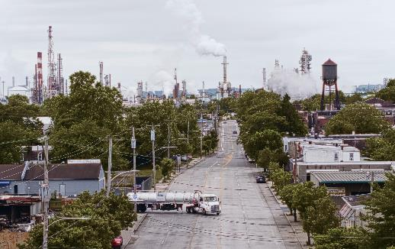
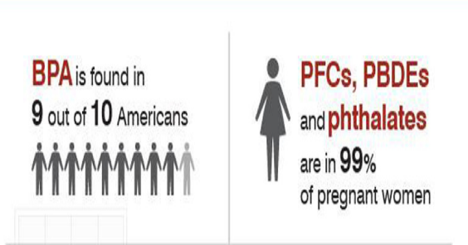

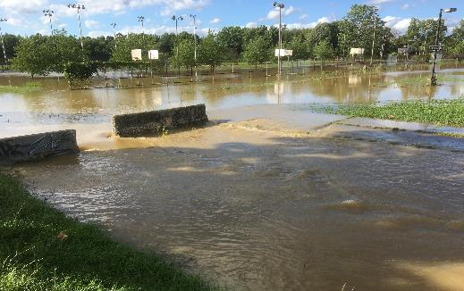
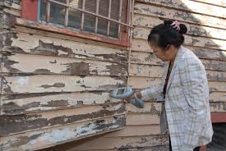
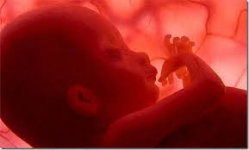
Exposures and Human Health Studied by CEET
Human Health
Air Pollution & Lung Health
Windows-of-Susceptibility
Environmental Exposures & Cancer
Environmental Neuroscience
Emergent Areas:
Climate Change & Health Exposomics

Slide 10
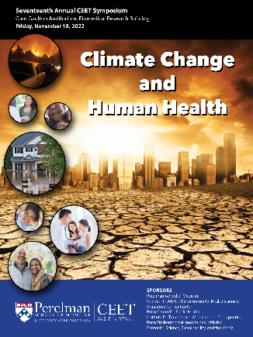
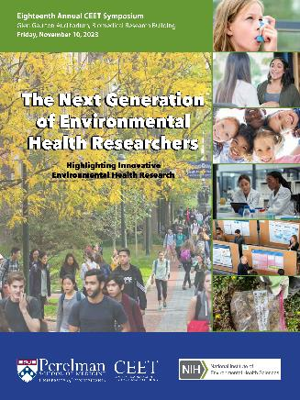
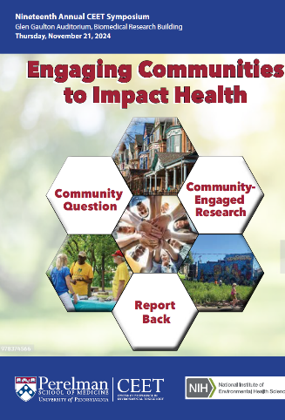
Certificate Program in Environmental Health Sciences
Cell Biology (BGS Requirement, if applicable)
Foundations in Statistics (BGS Requirement, if applicable)
Experimental Genome Science (GCB 5340/PHRM 5340)
Molecular Toxicology (PHRM 5900)
Environmental Epidemiology (EPID 7110)
Data Science for Biomedical Informatics (BMIN 5030)
CEET-Seminar Series and Symposium
Research in Progress Monthly Meeting
Course Requirements for Diplomat American Board
Toxicology
T32 Training Grant in EHS (T32-ES019851) –
internships available with EPA, Silent Spring,
Research Institute for Fragrance Materials
Three Rotations in EHS, one Community-Based
Experience (over 40 faculty across BGS)
Annual CEET Symposiums

Slide 11
Prepares Students for a Suite of Careers
Optional externships/ experiential learning opportunities outside of Penn.
Encouraged to become board certified as “Diplomats of the American Board of Toxicology”
Alumni working in toxicology, risk-assessment, environmental and occupational health sciences – in academia, industry, (pharmaceutical, food, cosmetic and nanotechnology), governmental agencies
Nicole Robles-Matos, PhD
Toxicologist
US EPA
Jessica Murray, PhD
PI Inhalation Toxicology
US EPA
Isabelle Lee, PhD
Senior Scientist
Research Institute for Fragrance Materials

Slide 12

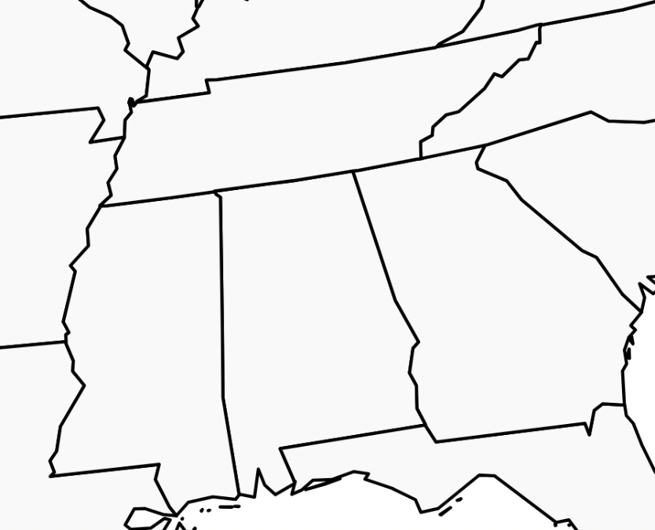


Why is it important we do this work?
Rose Albert
PGG 3rd Year

Slide 13


Why is it important we do this work?

Slide 14
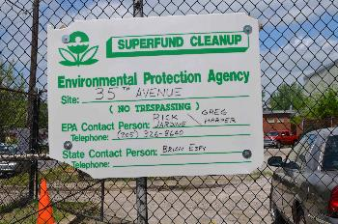
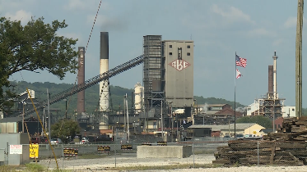
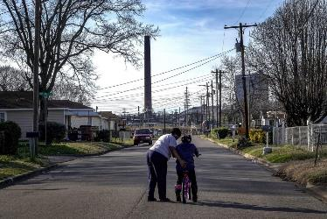
Why is it important we do this work?

Slide 15
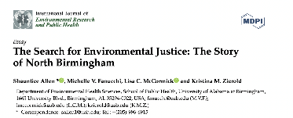
Why is it important we do this work?

Slide 16
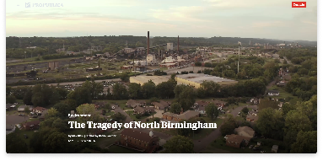
Why is it important we do this work?
“No Southern city has experienced a longer and more damaging legacy of environmental injustice than Birmingham.” – ProPublica

Slide 17
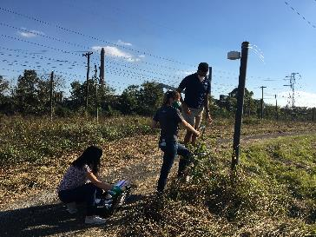
Why is it important we do this work?
“No Southern city has experienced a longer and more damaging legacy of environmental injustice than Birmingham.” – ProPublica

Slide 18
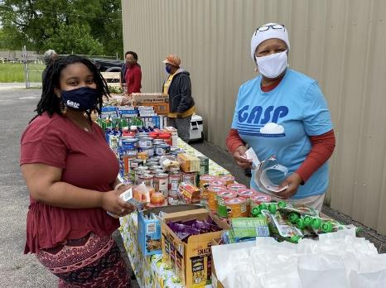
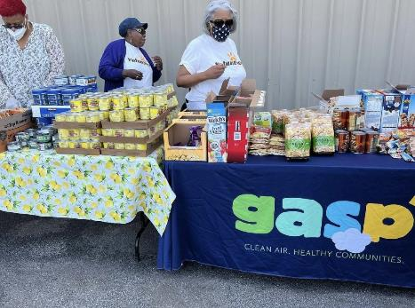
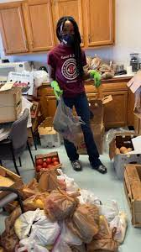
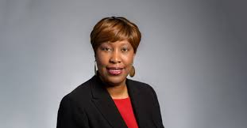
Why is it important we do this work?
“No Southern city has experienced a longer and more damaging legacy of environmental injustice than Birmingham.” – ProPublica

Slide 19



Why is it important we do this work?
“No Southern city has experienced a longer and more damaging legacy of environmental injustice than Birmingham.” – ProPublica

Slide 20
Why is it important we do this work?
“No Southern city has experienced a longer and more damaging legacy of environmental injustice than Birmingham.” – ProPublica
Reliable, publicly available data is one of the most powerful ways to fight injustice.

Slide 21
Training Opportunities through CEET
Rotation #1: Trevor Penning
How do human enzymes metabolize air pollutants from diesel exhaust?
Rotation #2: Rebecca Simmons
How does gestational exposure to endocrine disrupting chemicals disrupt fetal development?
Rotation #3: Krithika Lingappan (Thesis Lab)
How do sex-specific mechanisms increase male vulnerability to postnatal exposures?
Notes:
Rose Albert, a graduate student in the Certificate Program in Environmental Health Sciences working with CEET researcher Krithika Lingappan, created materials translating the CEET’s lung cancer risk / air pollution study. The QR code leads to a landing page that provides local information about how to schedule lung cancer screening in Philadelphia, Camden, NJ and Delaware.
Ceire Hay, a graduate student in the Certificate Program in Environmental Health Sciences working with CEET researcher Sarah Henrickson, created a brochure that describes the need for flu vaccination and makes the connection between severe flu and obesity as a risk factor. The brochure was distributed to more than 20 pharmacies and primary care physician offices and submitted to the Partnerships for Environmental Public Health (PEPH). This CEET will continue to use this brochure at our outreach events.

Slide 22
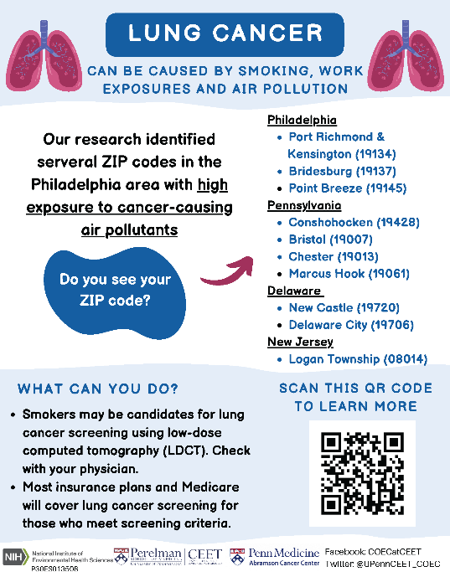
Training Opportunities through CEET
Rotation #1: Trevor Penning
How do human enzymes metabolize air pollutants from diesel exhaust?
Rotation #2: Rebecca Simmons
How does gestational exposure to endocrine disrupting chemicals disrupt fetal development?
Rotation #3: Krithika Lingappan (Thesis Lab)
How do sex-specific mechanisms increase male vulnerability to postnatal exposures?
Community Engagement Rotation: Air Pollution and Cancer Risk
Notes:
Rose Albert, a graduate student in the Certificate Program in Environmental Health Sciences working with CEET researcher Krithika Lingappan, created materials translating the CEET’s lung cancer risk / air pollution study. The QR code leads to a landing page that provides local information about how to schedule lung cancer screening in Philadelphia, Camden, NJ and Delaware.
Ceire Hay, a graduate student in the Certificate Program in Environmental Health Sciences working with CEET researcher Sarah Henrickson, created a brochure that describes the need for flu vaccination and makes the connection between severe flu and obesity as a risk factor. The brochure was distributed to more than 20 pharmacies and primary care physician offices and submitted to the Partnerships for Environmental Public Health (PEPH). This CEET will continue to use this brochure at our outreach events.

Slide 23
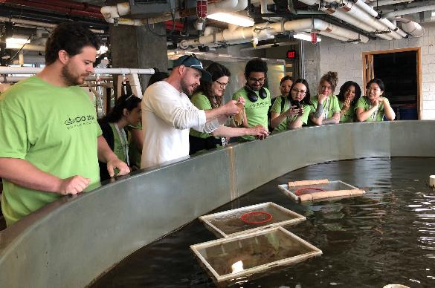
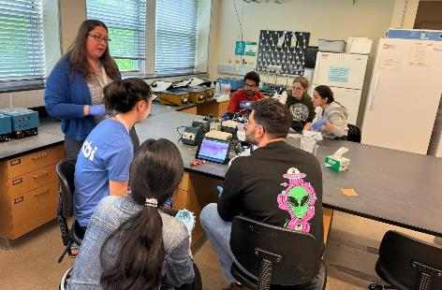
Training Opportunities through CEET
Rotation #1: Trevor Penning
How do human enzymes metabolize air pollutants from diesel exhaust?
Rotation #2: Rebecca Simmons
How does gestational exposure to endocrine disrupting chemicals disrupt fetal development?
Rotation #3: Krithika Lingappan (Thesis Lab)
How do sex-specific mechanisms increase male vulnerability to postnatal exposures?
T32 Travel funds for off-site course at the Marine Biological Laboratory
Community Engagement Rotation: Air Pollution and Cancer Risk
Rose.albert@pennmedicine.upenn.edu
Notes:
Rose Albert, a graduate student in the Certificate Program in Environmental Health Sciences working with CEET researcher Krithika Lingappan, created materials translating the CEET’s lung cancer risk / air pollution study. The QR code leads to a landing page that provides local information about how to schedule lung cancer screening in Philadelphia, Camden, NJ and Delaware.
Ceire Hay, a graduate student in the Certificate Program in Environmental Health Sciences working with CEET researcher Sarah Henrickson, created a brochure that describes the need for flu vaccination and makes the connection between severe flu and obesity as a risk factor. The brochure was distributed to more than 20 pharmacies and primary care physician offices and submitted to the Partnerships for Environmental Public Health (PEPH). This CEET will continue to use this brochure at our outreach events.

Slide 24
CEET Promotional Video

Slide 25
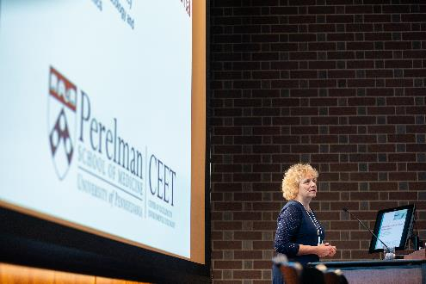
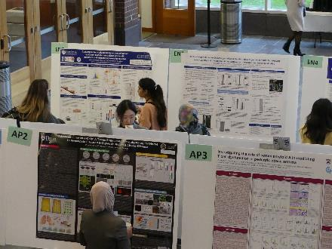
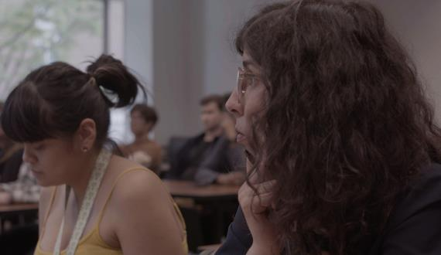
How to apply?
Administrative Contact
Jenn Kuklinski: jkuklins@pennmedicine.upenn.edu
Training Grant Directors
Blanca Himes, PhD: bhimes@pennmedicine.upenn.edu
Trevor Penning, PhD: penning@upenn.edu
Becky Simmons, MD: rsimmons@pennmedicine.upenn.edu

